Slide 1
Kentucky Extension
Homemakers Association
(KEHA) Leader Lesson

Slide 2
Session Objectives
Understand what is in your estate
Discuss estate planning considerations
Document your wishes

Slide 3
What Do You Cherish?
Think about a cherished possession you have received from a loved one.
How did you inherit the item, and what makes it special to you?
3

Slide 4
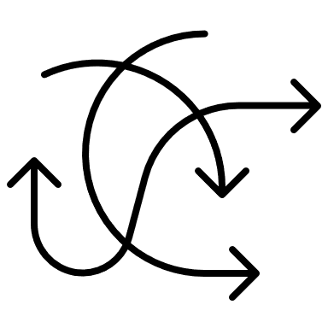
Importance of Planning
Even if you have an estate plan for your titled property, your executor may not know how to best distribute the full contents of your estate.
From cherished possessions to clutter
Where do I start?

Slide 5
What is Non-Titled Property?
No legal documents
No real estimated financial value
May hold sentimental value

Slide 6
Legal Considerations
Lists may not be legally binding
Including non-family members
Possessions of monetary value
Managing Estate Taxes

Slide 7
Passing on Possessions
Think about one special item you would like to pass on to someone in your family.
How do you plan to pass this item on?
Is there a story behind it?
What makes it special?
7

Slide 8
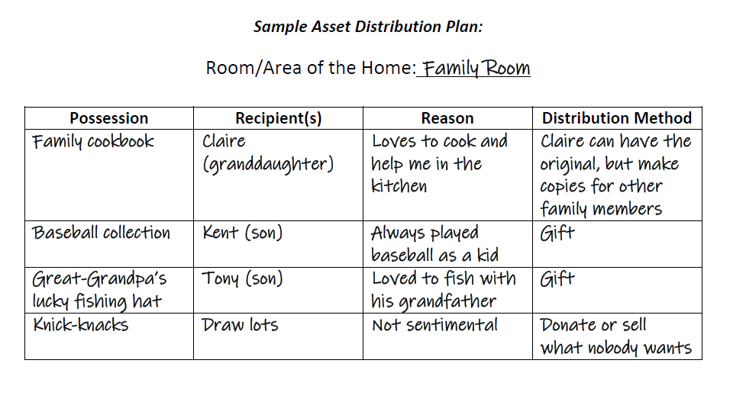
Asset Distribution Plan

Slide 9
Letter of Last Instruction
Provides instructions for your estate settlement, funeral arrangements, final wishes, locations of important documents
Use the Letter of Last Instruction handout to guide you in writing your own letter after this lesson.

Slide 10
For additional information, contact your county FCS Agent
to ask about completing the extended four-lesson curriculum.

Slide 11
Nichole Huff, PhD, Extension Specialist for Family Finance and Resource Management
nichole.huff@uky.edu
With contributing efforts provided by:
Tiyani Rodrigo and Miranda Bejda
Copyright © 2022 for materials developed by University of Kentucky Cooperative Extension. This publication may be reproduced in portions or its entirety for educational or nonprofit purposes only. Permitted users shall give credit to the author(s) and include this copyright notice.
Educational programs of Kentucky Cooperative Extension serve all people regardless of economic or social status and will not discriminate on the basis of race, color, ethnic origin, national origin, creed, religion, political belief, sex, sexual orientation, gender identity, gender expression, pregnancy, marital status, genetic information, age, veteran status, or physical or mental disability.
11

