Slide 1
Lesson 4:
How Can We Communicate
Without Conflict?
[Agent Name]

Slide 2
Session Objectives
Identify ways to increase clarity when communicating your plans
Develop communication strategies for estate planning conversations
List at least 3 ways to minimize conflict in estate planning

Slide 3
Avoiding Conflict
Why is talking about THIS so hard?
3

Slide 4
Increasing Clarity
1. List cherished possessions
2. List non-sentimental possessions
3. Ask for help
4. Write a Letter of Last Instructions
5. Make your plans known
4

Slide 5
Preparing to Communicate
Look for an appropriate time and place for the conversation.
Involve all relevant parties in the conversation.
5

Slide 6
Communication Tips
Ask curious questions.
Use resources or experiences of others.
Be patient and consistent.
6

Slide 7
Minimizing Conflict
Look at the big picture
Be a good listener
Keep other issues at bay
Don’t sweat the small stuff
7

Slide 8
Siblings, Spouses, & Squabbles
Vignette
What would you do if you were John and Maggie? Why?
What should the family do to increase clarity and decrease conflict concerning these cherished possessions?
8

Slide 9
Questions or Comments?

Slide 10
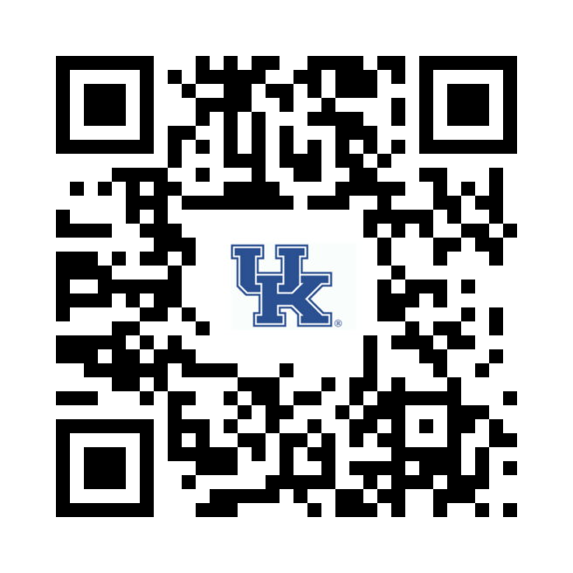
https://ukfcs.net/TCP-4
We value your feedback!

Slide 11
Nichole Huff, PhD, Extension Specialist for Family Finance and Resource Management
nichole.huff@uky.edu
With contributing efforts provided by:
Tiyani Rodrigo and Miranda Bejda
Copyright © 2023 for materials developed by University of Kentucky Cooperative Extension. This publication may be reproduced in portions or its entirety for educational or nonprofit purposes only. Permitted users shall give credit to the author(s) and include this copyright notice.
Educational programs of Kentucky Cooperative Extension serve all people regardless of economic or social status and will not discriminate on the basis of race, color, ethnic origin, national origin, creed, religion, political belief, sex, sexual orientation, gender identity, gender expression, pregnancy, marital status, genetic information, age, veteran status, or physical or mental disability.
11

