Slide 1
Lesson 3: Who Gets What?
[Agent Name]

Slide 2
Session Objectives
Create an asset distribution plan
Identify ways to outsource
Evaluate different methods of asset distribution

Slide 3
Passing on Possessions
Think about one of your cherished possessions that you would like someone to inherit.
Is there a story behind it?
What makes it special?
Who do you intend to receive it?
3

Slide 4
Deciding Who Gets What
Assets are the items in your home.
Some are cherished, some are not.
An asset distribution plan details how your assets will be distributed and disposed of upon your death.
Your plan should include four columns:
Possession
Recipient
Reason
Distribution method
4
Notes:
Take-home activity

Slide 5
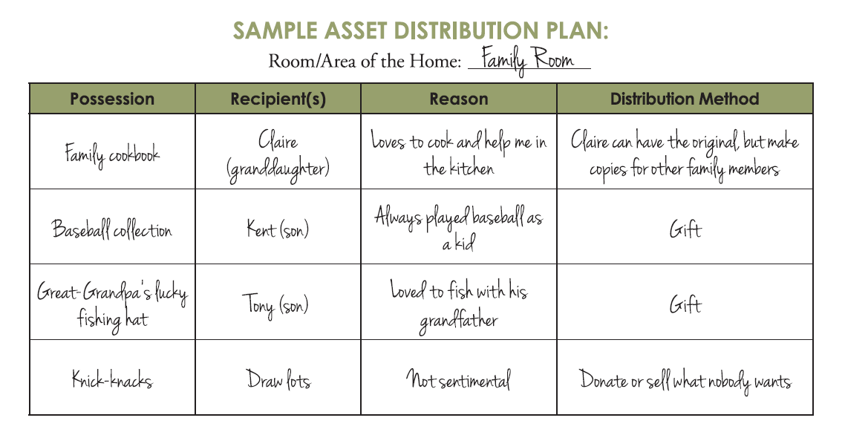
Asset Distribution Plan
5
Notes:
Take-Home Activity

Slide 6
Methods of Asset Distribution
Personal
Private
Public

Slide 7
Legal Considerations
Ensure your method is legal in Kentucky and complies with estate tax laws
Labeling may not be legally binding
Have an appraiser estimate the worth of valuable items
Consult an estate planner or attorney

Slide 8
Personal Distribution
Itemized lists
Gifting items
DUPLICATION
8

Slide 9
Private Distribution
Making donations
Drawing lots
Private “auction”
Virtual distribution
9

Slide 10
Public Distribution
Garage sales
Estate sale
Public auction
Outsource
10

Slide 11
Let’s Discuss
Which method(s) would you use? Why?
Has your family used any of these methods in the past when settling a loved one’s estate?
If so, what went well?
What could have gone better?
Why?
11

Slide 12
Outsourcing Distribution
Liquidators oversee the selling of assets while the owner or estate receives the proceeds.
Senior Move Managers are hired professionals who provide services related to asset distribution, selling your home, or moving.
12

Slide 13
Woodwork & Wedding Rings
Vignette
Imagine you are Jane, and you want to begin distributing your assets:
Fill out the Asset Distribution Plan beginning with the rings and bedframe.
How did you come to these conclusions?
What could this family have done differently to improve clarity before Tom passed away?
13

Slide 14
Questions or Comments?

Slide 15
https://ukfcs.net/TCP-3
We value your feedback!

Slide 16
Nichole Huff, PhD, Extension Specialist for Family Finance and Resource Management
nichole.huff@uky.edu
With contributing efforts provided by:
Tiyani Rodrigo and Miranda Bejda
Copyright © 2023 for materials developed by University of Kentucky Cooperative Extension. This publication may be reproduced in portions or its entirety for educational or nonprofit purposes only. Permitted users shall give credit to the author(s) and include this copyright notice.
Educational programs of Kentucky Cooperative Extension serve all people regardless of economic or social status and will not discriminate on the basis of race, color, ethnic origin, national origin, creed, religion, political belief, sex, sexual orientation, gender identity, gender expression, pregnancy, marital status, genetic information, age, veteran status, or physical or mental disability.
16

