Slide 1
Lesson 1: Where Do I Start?
[Agent Name]

Slide 2
Session Objectives
Understand where to start
Evaluate legal considerations
Establish family goals

Slide 3
What Do You Cherish?
Think about a cherished possession you have received from a loved one.
How did you inherit the item, and what makes it special to you?
3

Slide 4
What is Non-Titled Property?
No legal documents
No real estimated financial value
May hold sentimental value

Slide 5
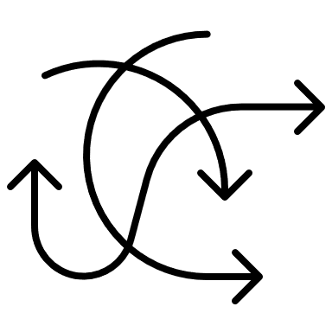
Importance of Planning
Even if you have an estate plan for your titled property, your executor may not know how to best distribute the full contents of your estate.
From cherished possessions to clutter
Where do I start?

Slide 6
Legal Considerations
Lists may not be legally binding
Consult with a trusted professional
Including non-family members
Assets of monetary value
Managing Estate Taxes
6

Slide 7
Non-Family Members
Stepchildren and foster children are not legal heirs unless formally adopted
Include non-family members in your will and Letter of Last Instructions

Slide 8
Managing Estate Taxes
All property belonging to Kentucky residents is subject to estate taxes
Discuss tax implications with an accountant or attorney when developing your estate plans
8

Slide 9
Family Goals
Uncertainty contributes to conflict
Sharing estate planning goals helps recipients understand why items are distributed a certain way
Goals also give you a better understanding of your family’s wishes
However, we often value different things:
Monetary value
Sentimental value
Historical value

Slide 10
Personal Property Goals
Support family members
Preserve family history
Make a donation
Respect family relationships
Reduce ‘only-child’ guilt

Slide 11
Mystery Memorabilia Vignette
If you were called in as a mediator, what would you do with the war memorabilia and why?
What goals might Julia, Sam, and Emily have for the distribution of the war memorabilia?
What other factors might affect the decision(s) being made by this family?
11

Slide 12
Letter of Last Instructions
Provides instructions for your estate settlement, funeral arrangements, final wishes, locations of important documents, etc.
Use the Letter of Last Instruction handout to guide you in writing your own letter after this lesson.
Warning … it can be an emotional activity

Slide 13
Questions or Comments?

Slide 14
https://ukfcs.net/TCP-1
We value your feedback!

Slide 15
Nichole Huff, PhD, Extension Specialist for Family Finance and Resource Management
nichole.huff@uky.edu
With contributing efforts provided by:
Tiyani Rodrigo and Miranda Bejda
Copyright © 2023 for materials developed by University of Kentucky Cooperative Extension. This publication may be reproduced in portions or its entirety for educational or nonprofit purposes only. Permitted users shall give credit to the author(s) and include this copyright notice.
Educational programs of Kentucky Cooperative Extension serve all people regardless of economic or social status and will not discriminate on the basis of race, color, ethnic origin, national origin, creed, religion, political belief, sex, sexual orientation, gender identity, gender expression, pregnancy, marital status, genetic information, age, veteran status, or physical or mental disability.
15

