Slide 1
INTERACTING WITH SOMEONE WITH CANCER
AGENT
DATE
Notes:
Knowing what to say to someone who has been diagnosed with cancer can be hard. Talking to someone with cancer often creates fears of saying something inappropriate or making the person upset. As a result, many people talk in whispers or opt to say nothing at all.
You are not alone if you do not know what to say or do when someone has cancer. But do not further isolate the person living with cancer by doing or saying nothing. Keep the following tips in mind and do what makes you most comfortable. Find ways to share your interest or concern, provide encouragement, and offer support.
DISCUSSION: What is your experience and/or fear about talking with someone with cancer?

Slide 2
CANCER DOES NOT MEAN SILENCE
The American Cancer Society (2019) encourages you to speak from the heart:
“I’m not sure what to say, but I want you to know I care.”
“I’m sorry to hear that you are going through this.”
“How are you doing?”
“If you would like to talk about it, I’m here.”
“Please let me know how I can help.”
“I’ll keep you in my thoughts.”
Notes:
Despite prevalence, increasing cancer survival rates, and advanced medical technology to treat cancer, family members, friends, loved ones, and co-workers continue to wonder what to say to someone who has been diagnosed with cancer (American Cancer Society, 2019; Cancer Treatment Centers of America, 2019). Some of this stems from personal fears and uneasiness with this daunting disease. For others, it is a reminder of personal mortality (American Cancer Society, 2019). Regardless of the reasons for keeping cancer at arms-length, people living with cancer have voiced that they do not like when the elephant in the room gets ignored, nor is it helpful to hear, “I know how you feel.” No one really knows exactly how someone with cancer feels because cancer and treatment affect each person differently.
The American Cancer Society (2019) encourages you to “respond from the heart” and offers the following ideas:
“I’m not sure what to say, but I want you to know I care.”
“I’m sorry to hear that you are going through this.”
“How are you doing?”
“If you would like to talk about it, I’m here.”
“Please let me know how I can help.”
“I’ll keep you in my thoughts.”

Slide 3
CANCER ETIQUETTE 101
Choose words wisely
Avoid talking about yourself too much
Laugh
Act normal
Listen
Don’t minimize someone’s experience
Follow their lead
Be considerate
Make them feel needed or important
Share encouraging stories
Mean what you say
Respect privacy
Use humor carefully
Be honest
Show respect
Notes:
Cancer survivors have shared awkward moments and upsetting encounters so people can learn what to say. Many people say things without even realizing they are being offensive or inappropriate (Cancer Treatment Centers of America, 2019). So Cancer Treatment Centers of America developed the following “cancer etiquette” or rules of conduct for communicating with the cancer community to help you talk to someone who has cancer.
It is important to note that each person experiences cancer differently ― even those with the same type ― so the same approach may not work for everyone.
The American Cancer Society and the Cancer Treatment Centers of America (2019) suggest the following talking points to communicate with someone about their cancer. And most importantly, they stress talking about it in a way that feels most comfortable to you so that you can express care, concern, encouragement, and support (American Cancer Society, 2019).
Stay connected
Choose words wisely
Avoid talking about yourself too much
Laugh
Act normal
Listen
Don’t minimize someone’s experience
Follow their lead
Be considerate
Make them feel needed or important
Share encouraging stories
Mean what you say
Respect privacy
Use humor carefully
Be honest
Show respect

Slide 4
CHOOSE WORDS WISELY
Think about what you would want to hear or what you would find helpful
Put yourself in their shoes or think about their language
Avoid clichés
Notes:
Group Discussion: To say or not to say?! What works for you?
Choose your words wisely. One simple comment, while meant to inspire, can quickly unwind a person’s attitude and/or emotions (Cancer Treatment Centers of America, 2019). While some cancer patients may be inspired and find strength in clichés, it is important to consider that others interpret common cancer descriptions such as “brave,” “fighter,” “warrior,” and “inspirational” as additional pressure. For example, one woman shared that she felt if she “lost her battle” to breast cancer, that it would be because she had not fought hard enough or it would be because she gave up. Another woman said that she did not feel “brave” or “inspirational,” but that she was trying to live well the life she had left (BBC News, 2019). Before you speak, think about what you would need or want to hear. In addition, think about the person living with cancer — and use language appropriate to him/her because they may not think like you and be comforted by the same words that would comfort you.

Slide 5
THE WORLD DOES NOT REVOLVE AROUND YOU!
You may have a headache, but you don’t have cancer
Focus on your loved one or friend
Follow their lead
Notes:
Remind yourself that the world doesn’t revolve around you. You are not the one with cancer; therefore, avoid talking about your crazy day or aches and pains. Because that is NOT cancer and the patient needs their energy to fight their fight, not to comfort you. Instead, keep your focus on your friend or loved one and what they want to talk about. It is okay to take a break from cancer, but follow their lead. Talk about it if they want to, and ignore it temporarily if they want to (Cancer Treatment Centers of America, 2019).

Slide 6
LAUGH
Relieves stress
Good for your organs
Decreases heart rate and blood pressure = relaxation
Improves immune system
Relieves pain
Enhances mood
Makes difficult situations more tolerable
Connects you to other people
Notes:
Laugh. Share funny stories. Tell jokes. According to the Mayo Clinic (2019), laughing and giggling is a healthy form of stress relief. In the short-term, laughter increases the intake of oxygen-rich air, which is good for organs. Laugher also decreases heart rate and blood pressure, which creates a relaxed feeling. Long-term effects of laughter include an improved immune system, pain relief, and enhanced mood. It can also help make difficult situations more tolerable to bear and connects you to other people (American Cancer Society, 2019; Mayo Clinic, 2019).

Slide 7
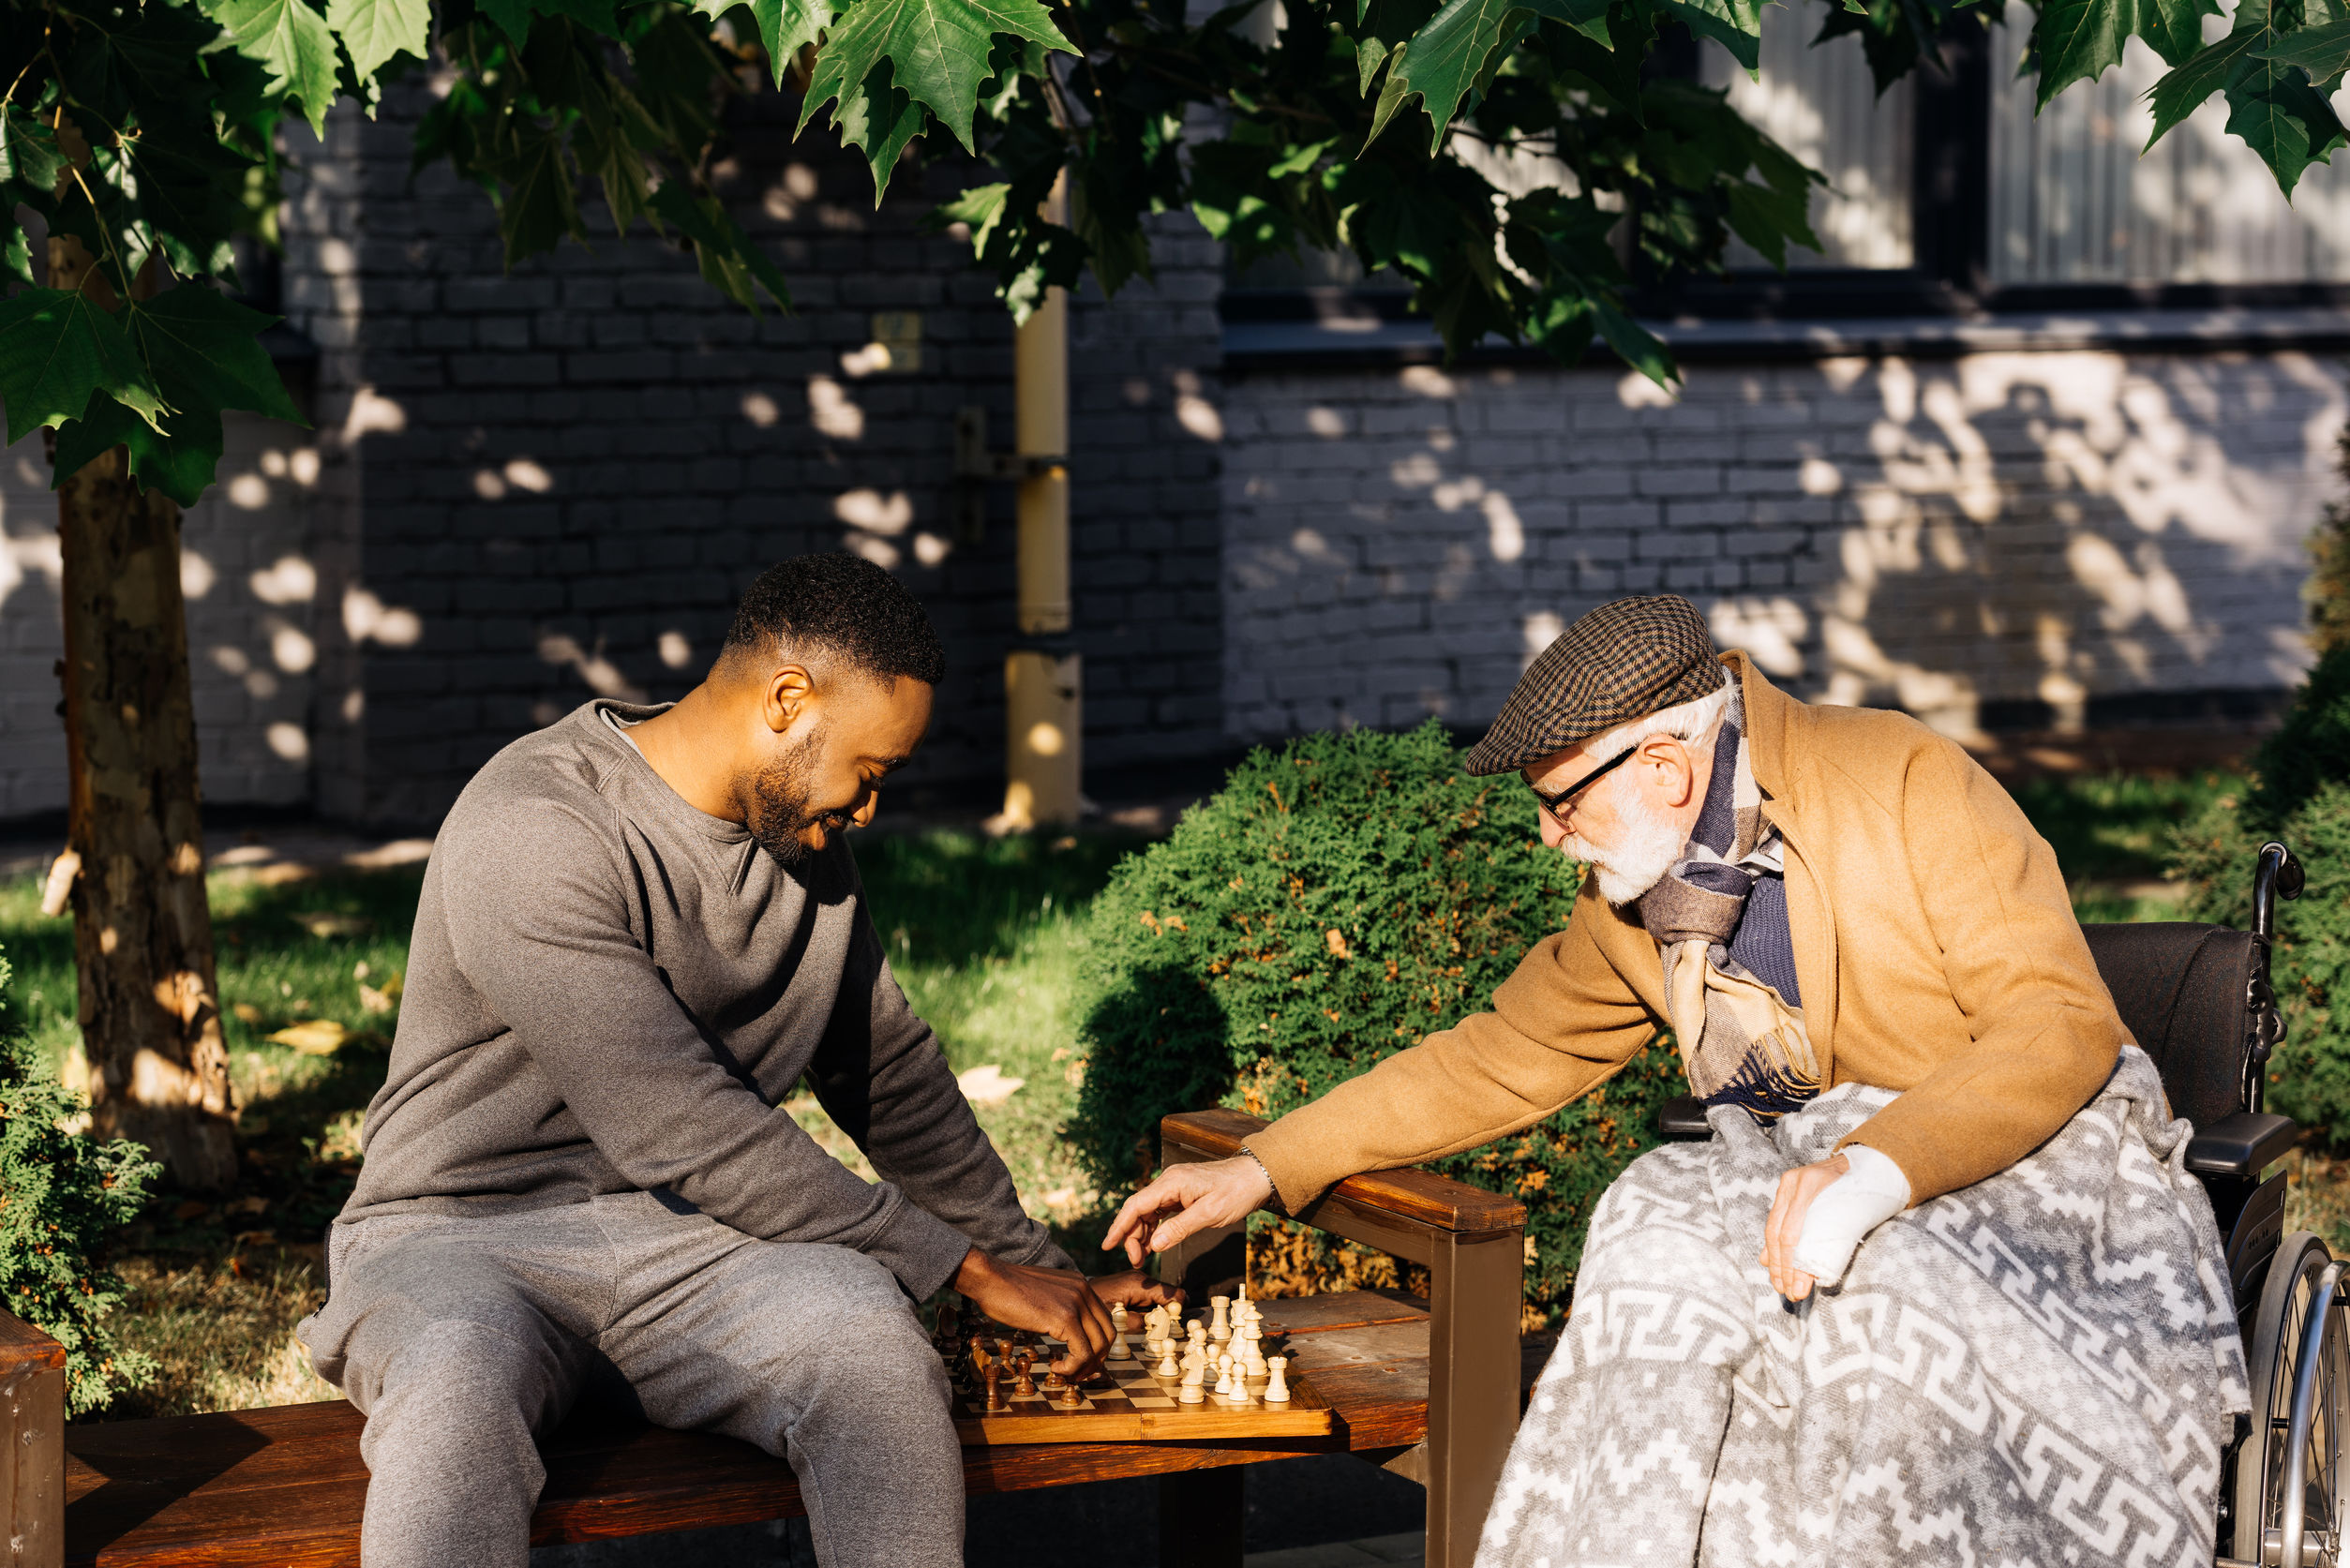
ACT NORMAL
Avoid ongoing pity parties
Tell the person with cancer you are glad to see them
Share a funny story
Do something fun
If you hugged or touched before the disease, continue to do so
Be flexible, but plan things to look forward to
Notes:
Act Normal. Cancer stinks, but a person living with cancer does not want to hear pity in your voice or see it in your eyes. Tell the person you are glad to see them. Share a story about something funny that has happened. Allow your loved one or friend to talk about cancer if he or she wants to. If you hugged or touched before the disease, continue to do so if it does not cause pain or discomfort (American Cancer Society, 2019; Cancer Treatment Centers of America, 2019).

Slide 8
LISTEN
Don’t just listen. Actually hear what the person is saying
Do not interrupt
You don’t have to have all of the answers
Silence is okay
Notes:
Be a good listener. Do not just listen, actually hear what the person is saying. Concentrate and process their words. Do not interrupt. You don’t have to have answers. Be empathetic. It is also okay to sit in silence together (American Cancer Society, 2019; Cancer Treatment Centers of America, 2019).

Slide 9
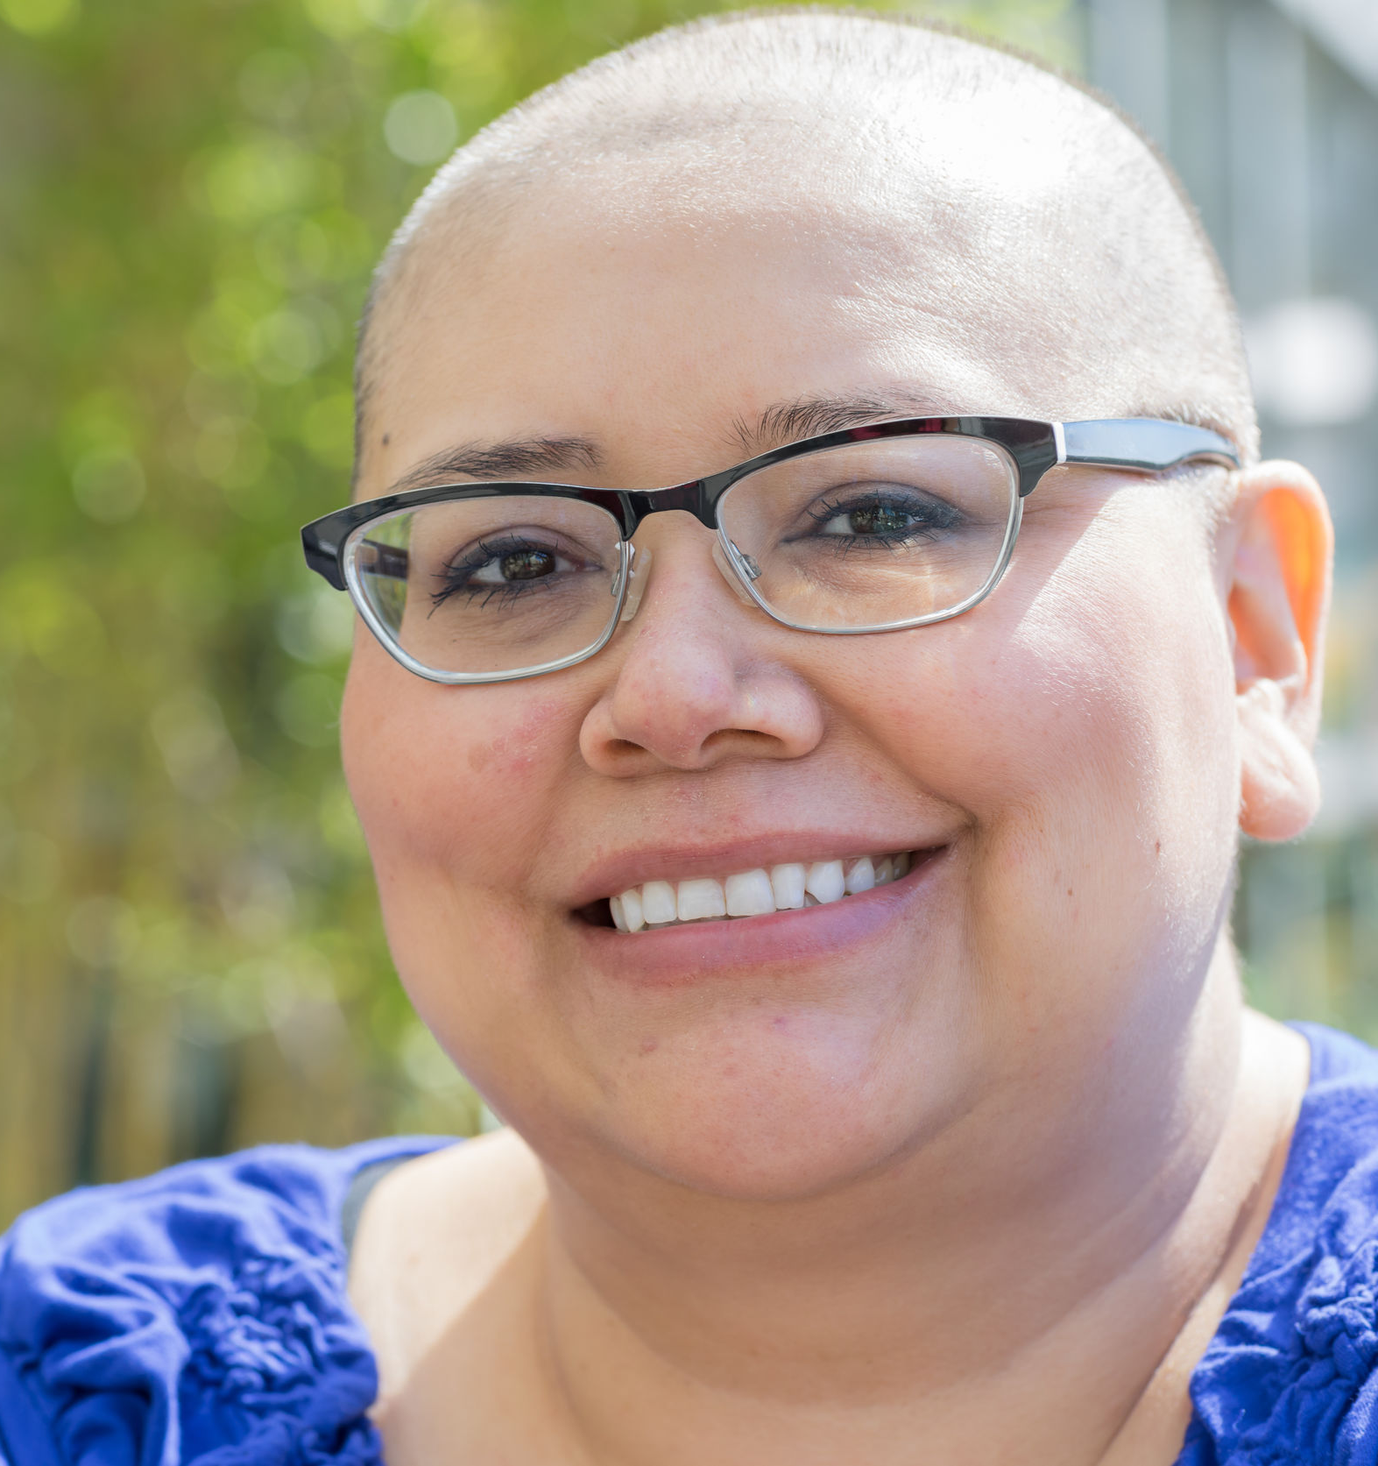
DON’T MINIMIZE SOMEONE’S EXPERIENCE
Every cancer and cancer experience is unique
Don’t downplay what someone is going through
Don’t compare to other people with the “same” or similar cancer
Notes:
Don’t minimize their experience. You don’t know that the person will be “fine” so don’t say that. Instead, tell them that you are “sorry” this is happening or that you “hope” it will be okay. Also remember, there is no “good” cancer, so don’t downplay what they are going through or what they have. Encourage the person to talk about his/her fears and concerns. Let a person feel sad. Let a person vocalize his or her fears and concerns (Cancer Treatment Centers of America, 2019). Don’t compare cancers and what another patient could or could not do.

Slide 10
FOLLOW THEIR LEAD
Some people want to talk about their cancer or experience
Some people are private
Some people need a break from cancer and want an opportunity to feel “normal”
Notes:
Follow their lead. Some people will be very open and want or need to talk about their cancer, treatment, and experience, while others will remain private. You do not always have to talk about cancer, and sometimes a person will want a break from cancer and an opportunity to feel “normal.” In those moments, exchange a funny story or talk about the day (American Cancer Society, 2019; Cancer Treatment Centers of America, 2019).

Slide 11
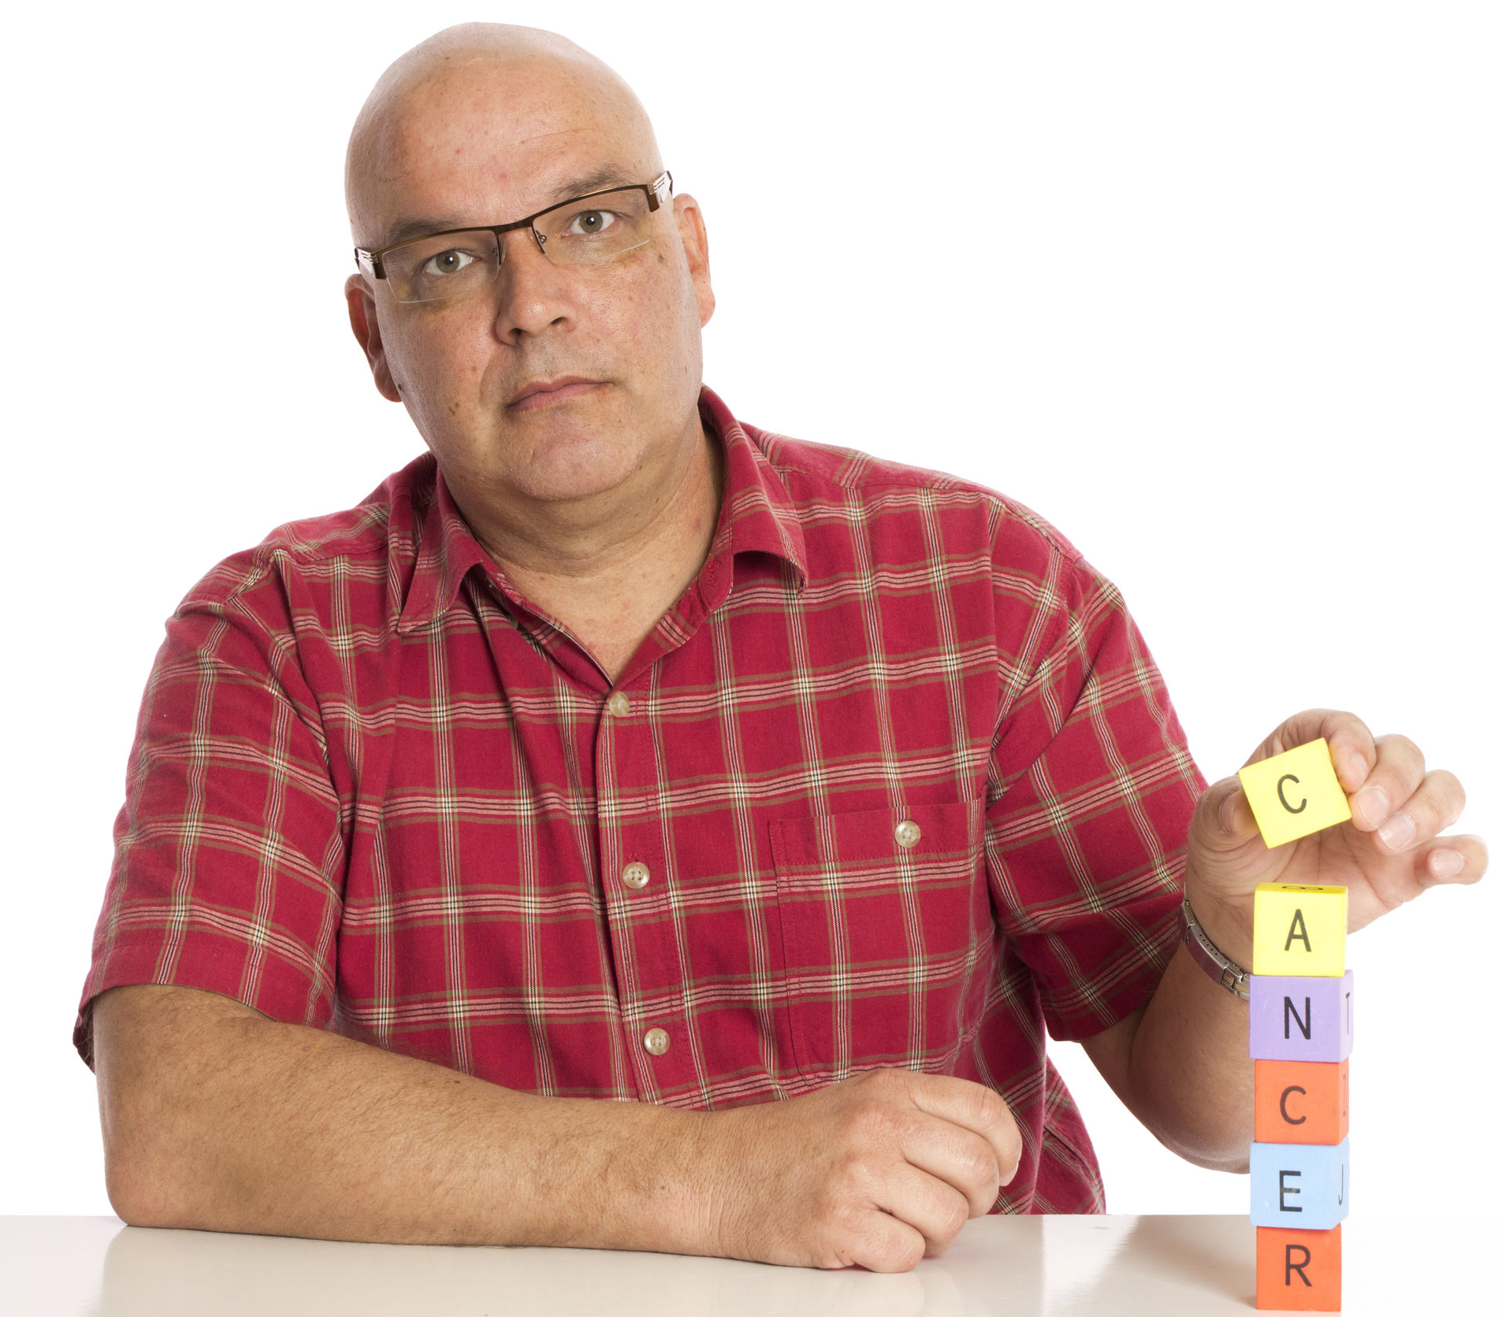
BE CONSIDERATE
If a person wants you to know certain details, let them tell you
Notes:
Be Considerate. Do not ask how many tumors they have, what stage cancer they are in, or how many months the doctor gave them to live. If a person wants you to know these things, they will share it (Cancer Treatment Centers of America, 2019).

Slide 12
MAKE THEM FEEL NEEDED AND IMPORTANT
Treat the person with cancer like you always have
Include them on projects
Invite them to social events
Let them say “no” or tell you that they cannot keep up
Give them a sense of purpose
Enhances physical health
Protects against heart disease
Helps with pain management
Leads to stronger relationships
Helps people find meaning in times of trouble
Notes:
Make them feel needed and important. Just because a person has cancer does not mean that they cannot be helpful or do anything. Treat the person like you have always treated the person and include them on projects, tasks, and social events as they always have. Let them tell you that they cannot do it or keep up (American Cancer Society, 2019). According to research (Leonard & Kreitzer, 2019), “living on purpose feels alive, clear, and authentic.” Purpose positively influences physical health, protects against heart disease, helps with pain management, and leads to better relationships. A sense of purpose can also help people find meaning in things that happen to them (Leonard & Kreitzer, 2019).

Slide 13
SHARE ENCOURAGING STORIES
Avoid stories with unhappy endings
If two people have a similar disease, try to connect them
Use positive stories for inspiration
Notes:
Share encouraging stories. Cancer patients like to hear cancer survivor stories, but do not say, “they had the same thing as you” because no two cancers are exactly the same. Instead, share a story and try to connect two people with similar diseases or use the story to let the person know you are familiar with cancer because you have been through it with another person. Avoid stories with unhappy endings (Cancer Treatment Centers of America, 2019).

Slide 14
MEAN WHAT YOU SAY
Don’t comment on physical appearance unless you mean it
Tell a person they look “beautiful” or that they are “looking stronger”
Notes:
Talk about their appearance and mean what you say. Don’t comment about physical appearances unless you mean it. It is not nice to talk about pale complexion, weight loss, or hair loss — so don’t. Instead, if you mean it, tell the person he/she is beautiful or looking stronger (American Cancer Society, 2019; Cancer Treatment Centers of America, 2019).

Slide 15
RESPECT PRIVACY
It is not your job to tell others the details of someone’s cancer journey — unless they ask you to
If you find out from someone else — do not take it personally.
Notes:
Respect privacy. If someone tells you they have cancer, or shares details of their journey, it is not your job to tell others. If someone has not told you and you heard through the grapevine, don’t take it personally. It can take time for people to adjust to the diagnosis and feel ready to talk about it (American Cancer Society, 2019).

Slide 16
BE CAREFUL WITH HUMOR
Not everyone appreciates humor to cope
Let the person with cancer take the lead
It is better to join them in laughter than risking a joke that is not well-received
Notes:
Be Careful with Humor. Humor often helps in tough situations, especially coping. But it is not everyone’s approach to coping. Let the person with cancer take the lead. It is better to join them in laughter versus risking a joke about the situation that is not well-received (American Cancer Society, 2019).

Slide 17
BE HONEST
It is okay to admit that you are scared too
It is okay not to have all of the answers
Notes:
Be Honest. You are not an expert in cancer or dealing with it. It is okay to tell the person that you do not have experience with this and that you are scared or that you do not know what to say or do.

Slide 18
SHOW RESPECT
Respect a person’s decision and wishes, even if you disagree
Notes:
Show Respect. You may disagree with a treatment plan or decision, but it is important to respect the patient’s wishes and decisions (American Cancer Society, 2019).

Slide 19
WHEN SOMEONE HAS CANCER: DO SOMETHING!
Be Assertive
Be Normal
Be Honorable
Notes:
According to the American Cancer Society (2019), it is normal to feel sorry for someone with cancer or even guilty that you are healthy. They suggest turning those awkward, but real feelings into support. The following recommendations are things that you can DO for someone living with cancer (American Cancer Society, 2019):
Be Assertive. Instead of saying, “let me know if there is anything that I can do,” actually DO something. It is rare for someone to ask for help … so just do it. Babysit, drive to and sit through a treatment, get pedicures together, clean their house, run errands, deliver dinner, coordinate a visitation schedule, plan a party when treatment is over, etc.
Be Normal. Shower your loved one with love and normalcy. Show your loved one with cancer that you care and that they are still needed. Include them in activities and events, and keep inviting them unless they tell you otherwise.
Be Honorable. Make or organize a contribution to a charity, participate in a race for a cure, organize a blood drive, or make other special efforts in their name.
Discussion: What have you done or what do you suggest doing for someone with cancer?

Slide 20
The American Cancer Society has a lot more information that you might find helpful. Explore www.cancer.org or call the National Cancer Information Center toll-free number, 1-800-227-2345.
They are available to help you any time, day or night.
A support care video series is available to help with anything from self-care tips to training you in the physical care of your loved one. Visit cancer.org/caregivervideos to watch.

