Slide 1
CARING FOR SOMEONE WITH CANCER
AGENT NAME
DATE
Notes:
Many of today’s cancer treatments are provided at outpatient centers instead of hospitals. That means more patients, even those who are actively sick, can be at home where they may need day-to-day care and support. As a patient’s needs change with the course of the disease and/or treatment, it is common for caregiver roles to evolve. As a result, a primary cancer caregiver may wear many hats. They may serve as a companion, home health aide, chauffeur, chef, housekeeper, financial manager, or appointment maker. This presentation will help caregivers prepare for the evolving emotional and physical demands of cancer caregiving and highlight ways to take care of yourself.
QUESTION/DISCUSSION: By raise of hands — who knows someone with cancer or helps or has helped take care of someone with cancer. What are some of the hats you had to wear?

Slide 2

EDUCATE YOURSELF ABOUT THE DIAGNOSIS, TREATMENT AND SIDE EFFECTS
Learn about the diagnosis
Understand the disease process
Get an idea of what lies ahead
Notes:
According to the American Cancer Society, “one of the first steps after being told someone you love has cancer will be learning about their diagnosis. This will help you understand the disease process and get an idea of what lies ahead.
Reference:
American Cancer Society. (2019). Understanding the cancer experience when you’re a caregiver. Retrieved from https://www.cancer.org/treatment/caregivers/what-a-caregiver-does/treatment-timeline.html

Slide 3
ASK QUESTIONS:
  What kind of cancer is it?
  Where is it? Has it spread beyond where it started?
  What are the treatment options? Which do you recommend?
  What’s the goal of this treatment?
  How long will treatment last? What will it be like? Where will it be done?
  What side effects should we expect?
  How will treatment affect everyday activities?
  What’s the likely long-term outcome?
*These questions are recommended by the American Cancer Society
Notes:
According to the American Cancer Society (2019): Some of the first questions that you and the person with cancer should ask the doctor and/or the cancer care team are:
What kind of cancer is it?
Where is it? Has it spread beyond where it started?
What are the treatment options? Which do you recommend?
What’s the goal of this treatment?
How long will treatment last? What will it be like? Where will it be done?
What side effects should we expect?
How will treatment affect everyday activities?
What’s the likely long-term outcome?
Reference:
American Cancer Society. (2019). Understanding the cancer experience when you’re a caregiver. Retrieved from https://www.cancer.org/treatment/caregivers/what-a-caregiver-does/treatment-timeline.html

Slide 4
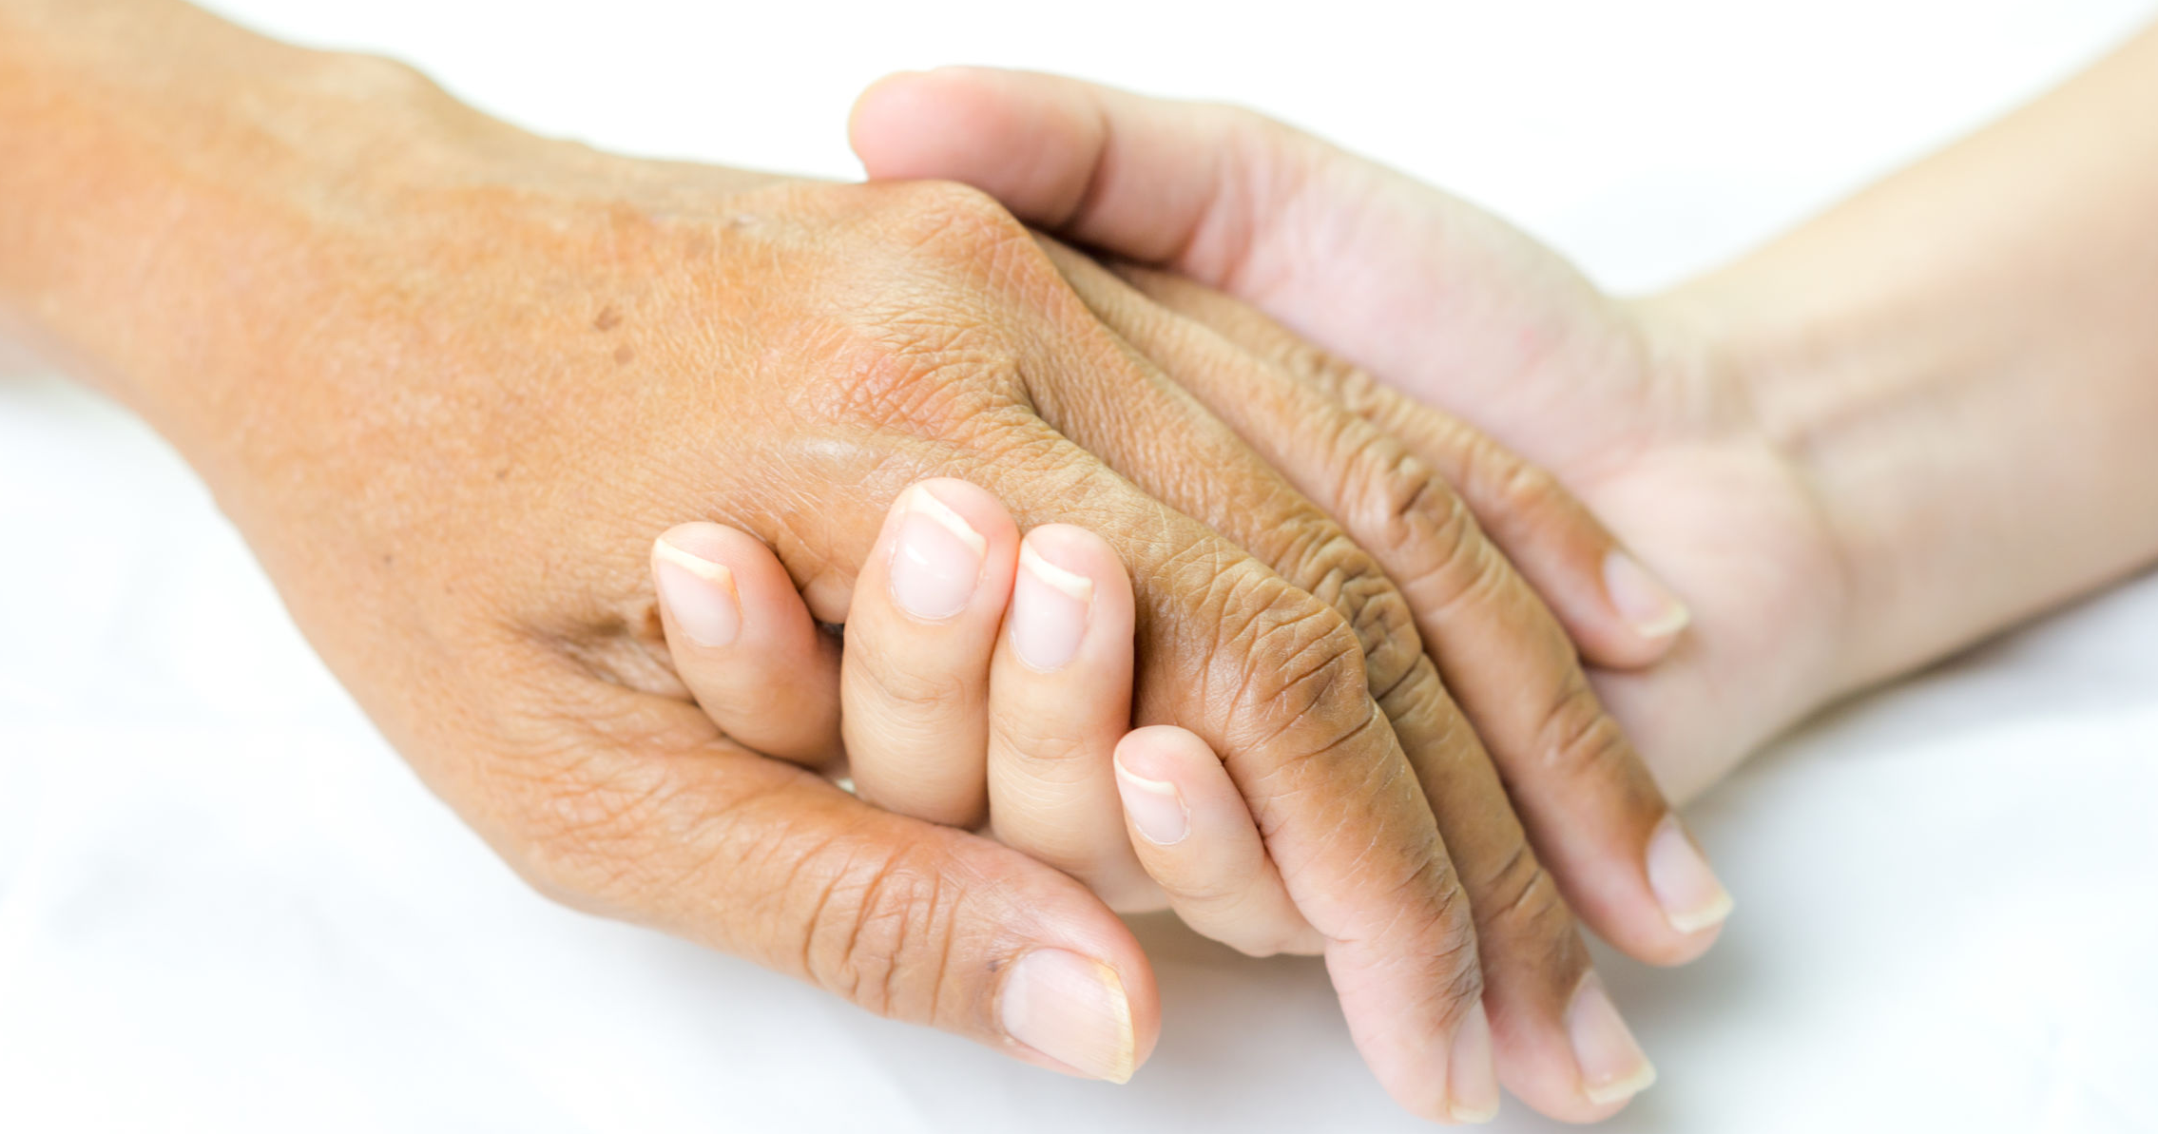
“Good communication with the person you are caring for is the most important part of your role.”
-American Cancer Society

Slide 5
BE A LIFELINE
When caregivers can worry about the details, patients can concentrate on their fight.
Grocery shop
Prepare meals
Do housekeeping and laundry
Care for children
Pay bills
Offer emotional support and companionship
Drive to and from appointments
Administer medications and manage side effects
Help with bathing, grooming, dressing
Assist in the bathroom
Transfer to and from bed
Help with eating
Manage finances and/or insurance issues
Notes:
The primary caregiver of a cancer patient is often a spouse, partner, parent, adult child, family member, or close friend.
They are not paid or trained to provide care, yet they are often the “lifeline” of a person with cancer because they provide ongoing care, support and encourage survival (American Cancer Society, 2019).
According to the American Cancer Society (2019), “good, reliable caregiver support is crucial to the physical and emotional well-being of people with cancer.”
Remember, when caregivers can worry about the details, patients can concentrate on their fight.
As many of you have already shared, you are LIFELINES to the people you know living with cancer.
According to the American Cancer Society (2019), caregivers can do these common day-to-day duties:
Grocery shop
Prepare meals
Housekeeping and laundry
Care for children
Pay bills
Offer emotional support and companionship
Drive to and from appointments
Administer medications and manage side effects
Help with bathing, grooming, and dressing
Assist in the bathroom
Transfer to and from bed
Help with eating
Manage finances and/or insurance issues

Slide 6
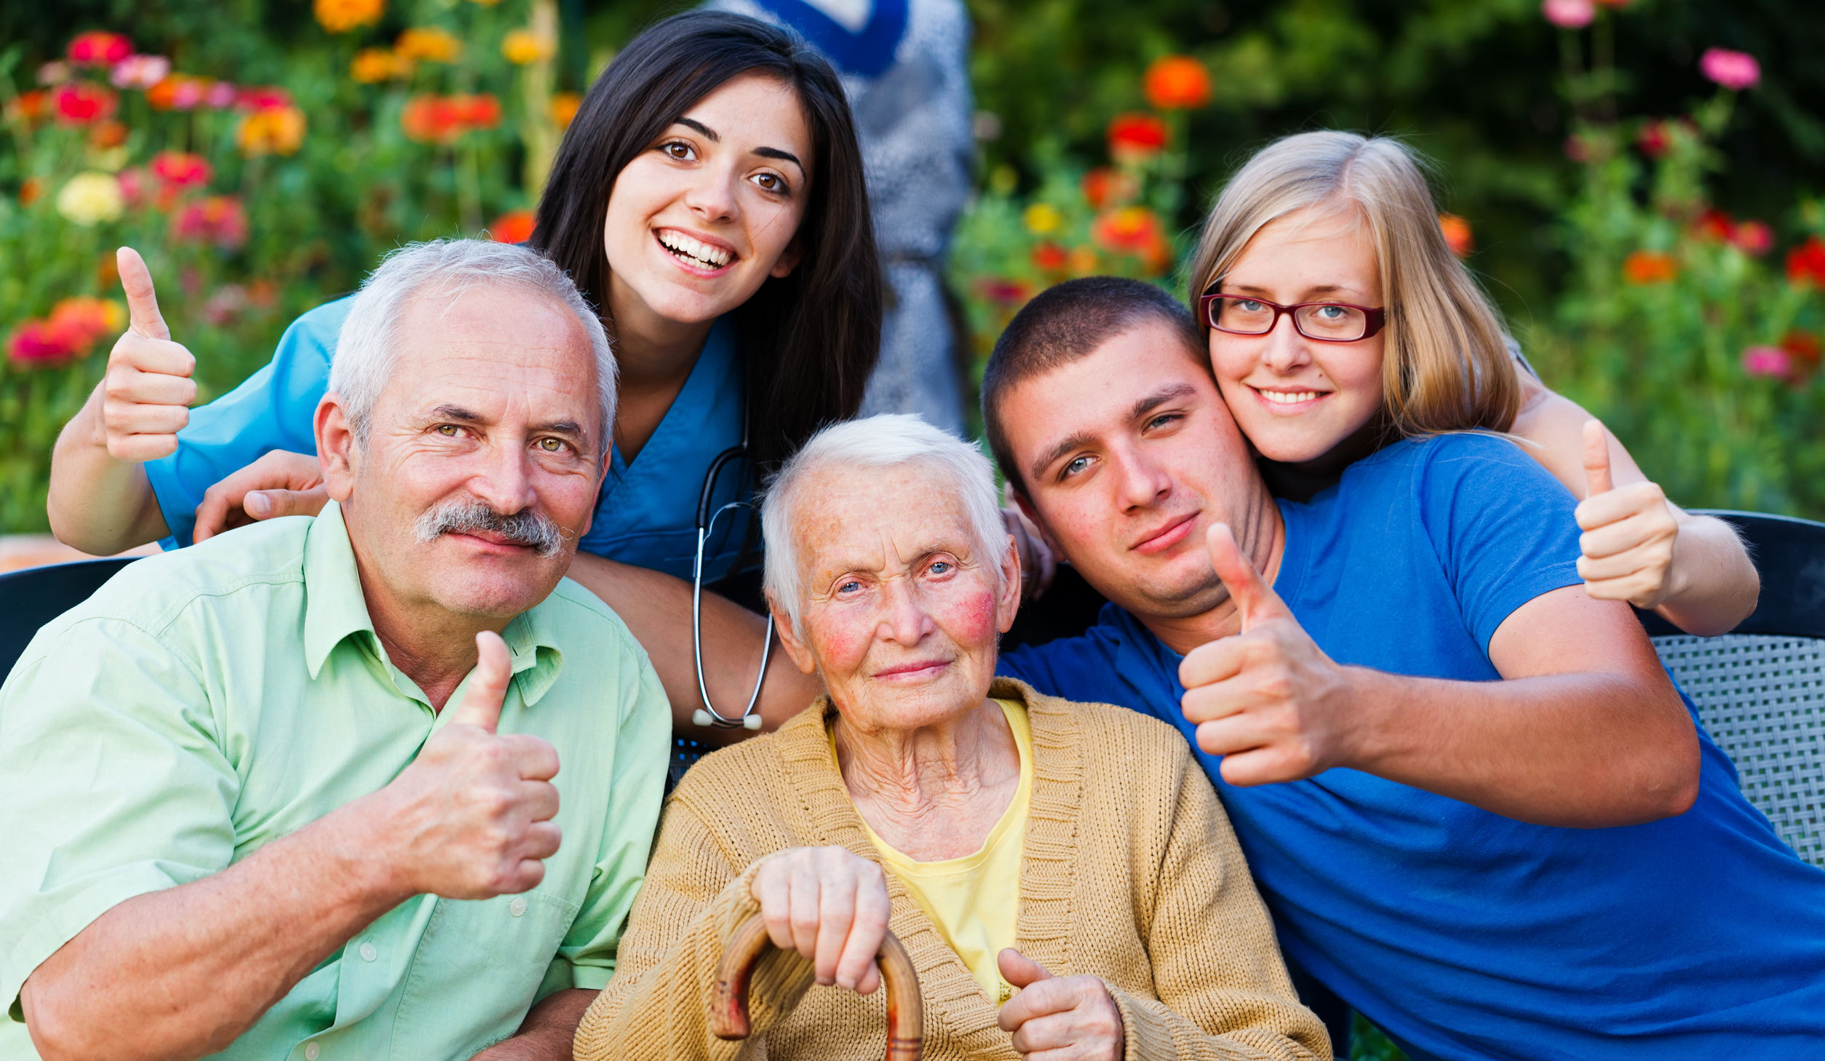
FORM A CAREGIVING TEAM
Keep other family members and friends informed
Find health-care professionals you trust
Coordinate patient care
Attend appointments, take notes, and ask questions
Oversee paperwork
Notes:
Because cancer caregiving has many roles and demands, it is best to form a team to help ensure that the person’s health and best interests come first.
A cancer team should include the patient, health-care professionals, family and friends, and the primary caregiver.
As a crucial member of the team, the primary caregiver is most often in charge.
According to the American Cancer Society (2019), as primary caregiver and head of the team, it is important to:
Educate yourself to keep other family members and friends informed. Learn about the diagnosis, treatment options, side effects, and proper support materials. The more you know, the more confident you and your loved one will feel to make decisions.
Find health-care professionals you trust, are experienced in your loved one’s form of cancer, and can provide individualized care, including managing side effects during treatment. Know the health-care professionals and how to contact them, including pharmacists.
Coordinate patient care. Keep records of medical history, medications, exams, test results, and make sure all health-care providers are communicating and on the same page, especially if there is a change in patient status such as new symptoms, changes in sleep, mood, bowel habits, or appetite. Communicate infections or hospitalizations.
Attend appointments to take notes and ask questions.
Oversee paperwork to prevent mix-ups and maintain records.

Slide 7

FORM A CAREGIVING TEAM, CONT.
Address concerns of family members and friends
Make sure the patient has everything she/he needs
Coordinate scheduled treatment plans, appointments, and therapies
Report problems
Help decide if treatment is working
Read and/or help update blogs, web pages, or group emails
Talk about end-of-life decisions and care
Notes:
According to the American Cancer Society (2019), as primary caregiver and head of the team, it is important to:
Address concerns of family members and friends with facts and logic
Make sure the patient has everything she/he needs while being treated and/or in the hospital (prescription and nonprescription medications, pajamas, and other comfort items)
Coordinate scheduled treatment plans, appointments, and therapies
Report problems
Help decide if treatment is working
Read and/or help update blogs, web pages, or group emails that provide updates about the person’s journey
Talk about end-of-life decisions and care

Slide 8

TAKE A BREAK FROM CANCER
Do something fun or meaningful
Make flexible plans you and your loved one can look forward to
Talk about things other than cancer
Provide reassurance that the person is more than the cancer
Give gifts that reflect who
they are apart from the
cancer
Notes:
A cancer patient is a vital member of the caregiving team. It is important to listen to your loved one and follow his/her lead (Cancer Treatment Centers of America, 2019). Sometimes they may not want to talk about cancer. Taking an occasional break from it can help make it seem like everything is not always about cancer.
The Cancer Treatment Centers of America (2019) recommends to:
Spend time together doing something fun
Make flexible plans, including future plans to which you and your loved one can look forward
Talk about things other than cancer
Provide extra encouragement and reassurance that the person is more than cancer. Tell him/her that they are loved and seen as a person
Give gifts that reflect who they are apart from the cancer (tickets to a movie or show, book, art, etc.)

Slide 9
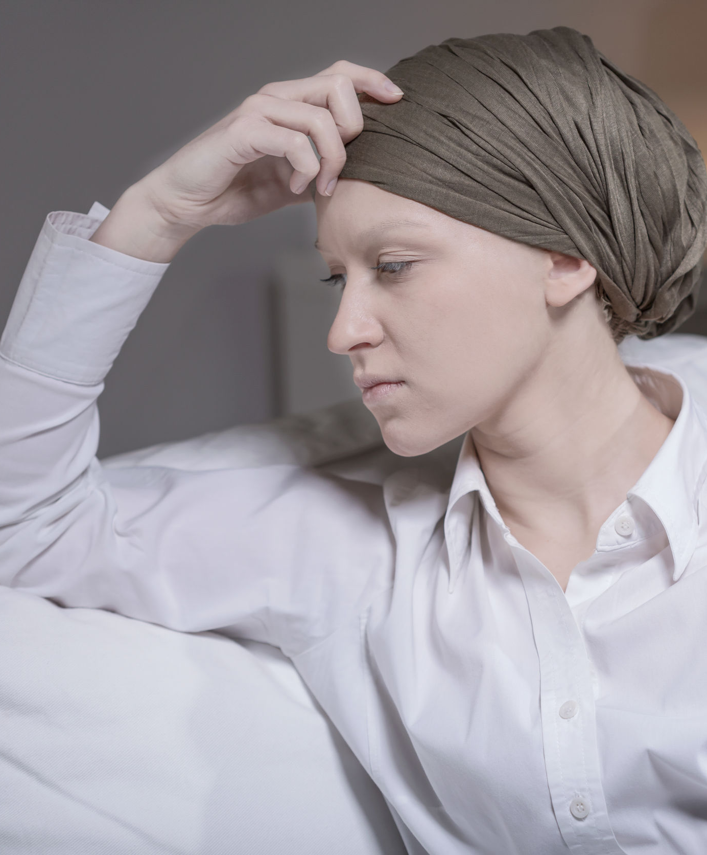
ACCEPT GOOD DAYS AND BAD DAYS
Let your loved one have a bad day
Do not take a bad day personally as a caregiver
Choose your words carefully
Notes:
It is not good to ignore uncomfortable topics or feelings. With cancer, there will be good days and bad days. Let your loved one have a bad day. Sometimes a person needs time to feel angry, to cry, and/or feel sorry for themselves.
When living with cancer, it is unrealistic to think someone can or should always be positive (Cancer Treatment Centers of America, 2019).
As a caregiver, it is easy to take a bad day personally or to sugar coat it by saying you know how they feel. Unless you have had their exact cancer, you do not know how they feel, so do not say this. Instead, say something like, “I love you.” “We will fight this together.”

Slide 10

BE EMPATHETIC
Think before you speak
  Process your own feelings and emotions about the cancer, diagnosis, treatment, side effects, etc., first
  Think about walking in your loved one’s shoes
Instead of focusing on the cancer, start a visit with: “It’s good to see you.”
Notes:
Think about a time when you were sick or scared. What did you want to talk about? What did you wish people said to you? How did you want to be treated?
When you try walking in someone else’s shoes, you can learn valuable lessons, such as empathy, new perspectives, more understanding, less judgment, and patience.
To properly walk in the shoes of and focus on someone living with cancer, it is important to learn about the diagnosis, prepare yourself for the expected changes during and after treatment, and process your feelings so that you can acknowledge and cope with your own emotions about the diagnosis and changes.
Some side effects associated with cancer include fatigue, hair loss, weight loss, vomiting or nausea, loss of appetite, pain, memory or concentration problems, diarrhea or constipation, fertility issues, mouth or throat problems, sleep problems, and swelling (National Cancer Institute, 2019).
Sometimes people focus on physical changes when they see someone with cancer. Instead of concentrating on the cancer, start a visit by saying, “It’s good to see you.”

Slide 11

TAKE CARE OF YOURSELF
On good days, you will feel good as a caregiver; you will know you have done well!
On bad days you may feel like giving up — THIS IS NORMAL.
Seek professional help if you start feeling overwhelmed or see these signs:
  Feeling depressed, physically sick, or hopeless
  Feeling like hurting yourself or your loved one
  Yelling at your loved one
  Depending on alcohol and drugs
  Fighting with your family
  Neglecting your own health or hygiene
Notes:
There is no recipe for cancer caregiving. It is not easy. But it is normal to have good days as a caregiver and on these days, you will know you did well. And you will have other days that you want to give up…and that’s okay too (American Cancer Society, 2019). If feeling overwhelmed becomes a constant problem, seek professional mental health. Signs that you need help include:
Feeling depressed, physically sick, or hopeless
Feeling like hurting yourself or your loved one
Yelling at your loved one
Depending on alcohol and drugs
Fighting with your family
Neglecting your own health or hygiene

Slide 12
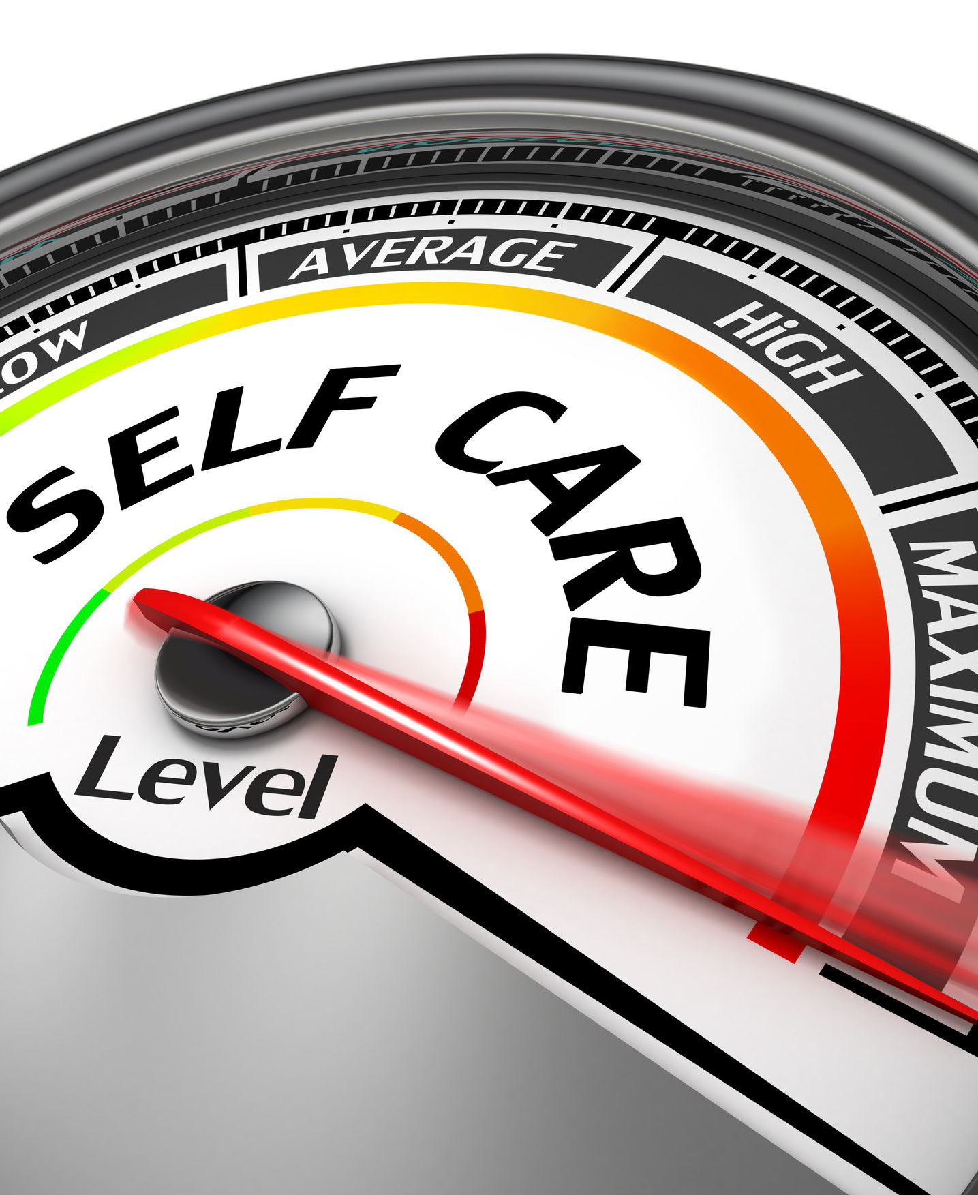
TAKE CARE OF YOURSELF, CONT.
Get involved
Be physically active
Eat healthy
Take 10 minutes for “me” time
Identify a sense of purpose
Engage in an activity that makes you feel good or relaxed
Set limits on what you can do, and ask for help for what you can’t do
Seek help from a mental health professional
Notes:
Because primary caregivers carry a lot of weight, one’s mental and physical health can be jeopardized. Therefore, it is important for caregivers to take care of themselves and recognize signs of stress. Signs of stress are not a sign of weakness; rather it is your body telling you that you are not balanced.
Over time, stress can lead to caregiver burnout (Help for Cancer Caregivers, 2019). Stress and burnout can make you feel:
Irritable
Anxious
Angry
Depressed
Frustrated
fearful
It can also cause:
weight gain
muscle and joint tension
Headaches
weight gain or loss
Fatigue
problems with digestion
chest pain
hair loss
issues with skin
weakened immune system
It can even increase risk of alcohol and substance abuse (Help for Cancer Caregivers, 2019).
To help you reduce caregiver stress, the American Cancer Society (2019) suggests that caregivers:
Get involved with family and community gatherings
Be physically active
Eat healthy
Take 10 minutes for “me” time
Identify a sense of purpose or accomplishment away from caregiving (finish a project, tackle a goal)
Engage in an activity that makes you feel good or relaxed (watch a movie, take a walk)
Set limits on what you can do and ask for help for what you can’t do
Seek help from a mental health professional

Slide 13
TURN PAIN INTO GAIN
Caregiver Pains
Caregiver Gains
Feeling unprepared
Physical and emotional symptoms
Depression
Feeling guilty or trapped
Time conflicts
Neglecting family responsibilities
Uncertain future, including unexpected and unwanted lifestyle changes
Seeing a loved one in pain
Making stressful medical decisions
Feeling you have to do it all
Financial worries
Guilt, fear, hopelessness, confusion, doubt, anger
Establish new friends and relationships
Draws families together at a time of need
Find new meaning and enrichment in life
Sense of pride
Recognizing a sense of purpose
Inner strength
Deep sense of satisfaction and intrinsic reward
Demonstrates care, devotion, love, respect
Feeling needed
Notes:
When you become the primary cancer caregiver, you become an integral member of the cancer team (American Cancer Society, 2019). The role is demanding and can at times, create conflict with your own schedule and ability to take care of yourself, and your own needs (American Cancer Society, 2019). According to the American Cancer Society (2019), the diagnosis of a loved one’s cancer can cause a wave of emotions. It is not uncommon for caregivers to feel shock, pain, frustration, sadness, and anger. There may be times when you are so grief stricken or emotionally and/or physically overloaded that it becomes too overwhelming to manage daily tasks and caregiving challenges. But caregivers can also experience joy, satisfaction, and meaning in their roles. It is not uncommon for cancer caregivers to find a hidden inner strength, which can contribute to a sense of purpose, confidence, accomplishment, and even pride. In this way, providing care demonstrates love and respect, and it helps you give back or do something at a time when you may feel helpless. Despite the demands, being a good caregiver and knowing how to take care of yourself will help you endure and continue in the caregiver role for the long run (American Cancer Society, 2019).

Slide 14

The American Cancer Society has a lot more information that you might find helpful. Explore www.cancer.org or call the National Cancer Information Center toll-free number, 1-800-227-2345.
They are available to help you any time, day or night.
A support care video series is available to help with anything from self-care tips to training you in the physical care of your loved one. Visit cancer.org/caregivervideos to watch.

Slide 15
QUESTIONS?

