Slide 1
MANAGING NUTRITION DURING CANCER
AGENT NAME
DATE

Slide 2
NUTRITION AND CANCER
Impact of Nutrition on Cancer
Impact of Cancer on Nutrition
Affects cancer outcomes
Tolerance to treatment
Quality of life
May increase calorie, protein, vitamin, and mineral needs
Cause side effects making it difficult to obtain nutrition
Notes:
Nutrition and cancer affect one another so it can be challenging and confusing about what to eat and how to eat.

Slide 3
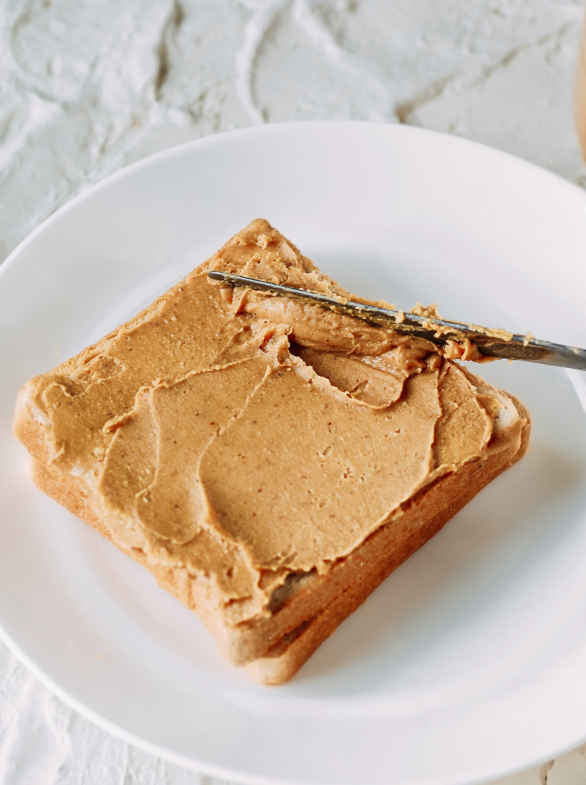
HEALTHY WAYS
TO MAINTAIN
BODY WEIGHT
Do not skip meals
Eat multiple small meals
Liquid calories
Include protein with each meal and snack
Exercise
Notes:
It is important to maintain a healthy weight and lean muscle.
It is common to lose weight, both fat and muscle, without trying during cancer treatment.
This may increase the risk of symptoms from treatment or intolerance of chemotherapy.
Liquid calories are easier to consume - they require less energy. Health-care providers recommend milkshakes, smoothies, or oral supplement drinks.
Protein helps us feel full and can help maintain muscle mass.
Exercise is a great way to increase quality of life. It may be difficult because of low energy, but even small amounts of resistance exercise with weights can help preserve muscle mass.
If you have any concerns about these, talk to your health-care team.

Slide 4
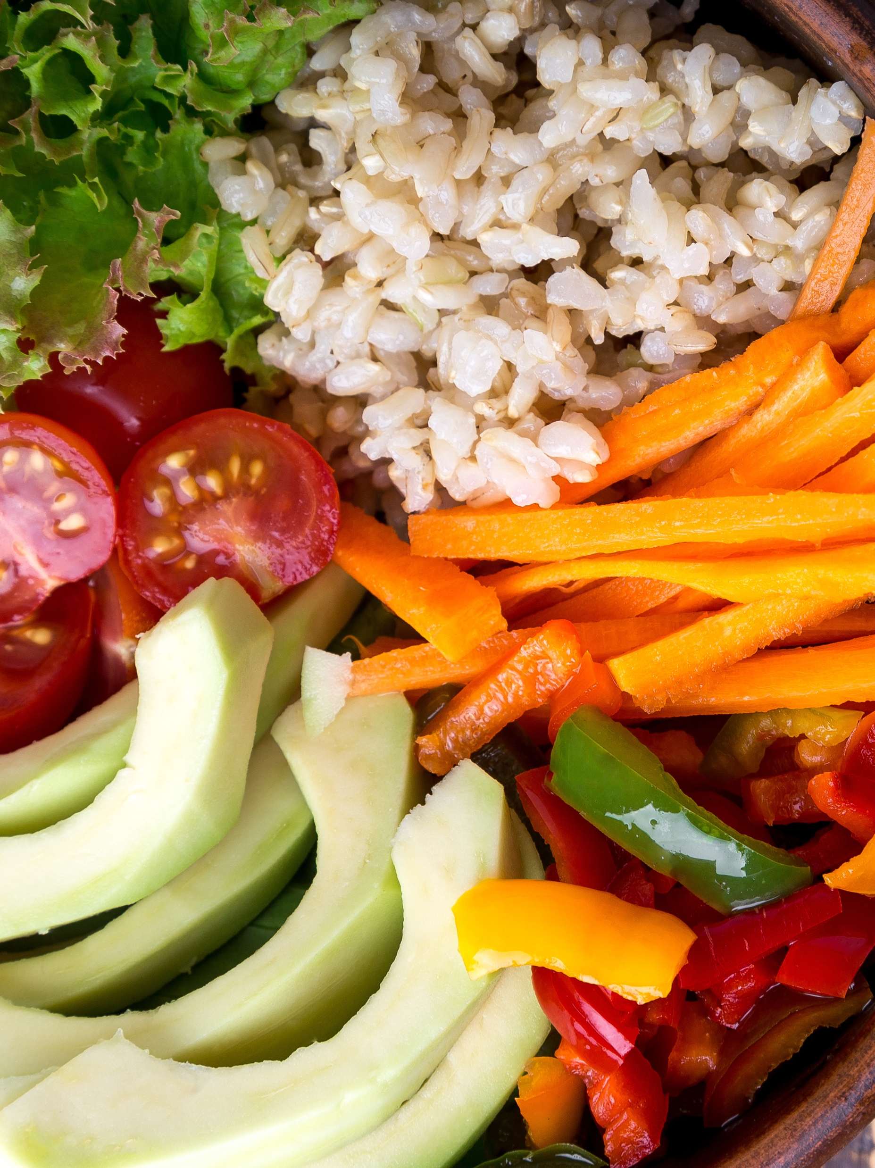
NUTRIENTS THAT
HELP THE BODY HEAL
Fruits, vegetables, and whole grains
Plant-based foods
Brightly colored foods
Phytochemicals
  Example: Lycopene – gives tomatoes and watermelon a red color
  Example: Anthocyanins – give berries a blue or black color
Notes:
Just like with other sicknesses, consuming certain foods during cancer treatment may help the body heal when it is sick or stressed.
Fruits, vegetables, and whole grains provide nutrients that help the body heal; all of these are plant-based foods.
Many brightly-colored foods get their color from something we call phytochemicals. These chemicals keep cells in the body healthy.

Slide 5
FOODS THAT HELP THE BODY HEAL
Fruits: add vitamins, minerals, phytochemicals, and fiber
  Berries, bananas, melon
Vegetables: add vitamins, minerals, phytochemicals, and fiber
  Leafy greens, beets, red cabbage, sweet potatoes
Grains: add fiber and protein
  Whole grains such as oatmeal, brown rice, barley, and even popcorn
Protein: makes you feel full, and good for muscle mass
  Beans, nuts, seeds
  Limit red meat (beef and pork) and processed meats (bacon, hotdogs)
Dairy: adds calcium, vitamin D, and protein
  Full-fat dairy may help add calories for those maintaining body weight
Notes:
A balanced diet — with foods from all food groups — is important. Remembering the nutrients to help the body heal, we can look specifically at all the food groups.
Fruit: Try to consume 2 to 3 servings of fruit each day. Include fruit at meals as a side dish, add fruit to your snacks, or use the sweet taste of fruit as your dessert. Try to eat 1 to 2 differently colored fruits each week to ensure you are taking in a variety. When possible, purchase fruits when they are in season at their peak for taste, nutrition, and affordability. Another economic option is to keep your freezer stocked with frozen fruits to quickly add to a meal or smoothie.
Vegetables: Purchasing in-season vegetables are going to taste the best. Canned vegetables with no salt added and frozen vegetables are healthy and economical options as well. Try to consume 4 to 5 servings of vegetables each day. This may seem like a lot to some, but think creatively about ways to add vegetables into your diet. For example, spinach and tomatoes go well in omelets for breakfast and many vegetables serve as easy, grab-and-go snacks.
Grains: Really focus on whole grains. There are also whole-grain versions of many of our favorite foods including bread, pasta, and crackers that are comparable in price and taste to refined versions. Some studies are beginning to show that diets rich in whole grains may be linked to lower rates of colon cancer.
Protein: Consuming enough protein is important for maintaining body weight and muscle mass. Research is starting to show us that different types of protein may have different roles in cancer prevention, management, and risk. Some cancer treatments can cause taste changes and intolerance to meat. If you are not eating meat, choose plant-based proteins. A plant-based diet is not a vegan diet and allows for occasional animal products but primarily consists of plant foods, similar to the USDA’s MyPlate guidelines.
Dairy: Choosing no-fat or low-fat dairy items still provides the same amounts of important minerals, vitamins, and protein. It is even suggested that low-fat dairy foods eaten in moderation may reduce the risk of colorectal cancers. For those in cancer treatment, consuming full-fat dairy products is an easy way to add calories into the diet when trying to maintain body weight.

Slide 6
MANAGING SYMPTOMS DURING CANCER TREATMENT
Appetite Loss
Drink oral nutrition supplements, milkshakes, and/or smoothies
Eat small meals throughout the day
Add high-fat condiments and toppings to increase calories without much volume
  Drizzle with olive oil, mix in peanut butter, top with sour cream
Drink beverages between meals and not with meals
Physical activity might help stimulate an appetite
Notes:
The goal of cancer treatment is to kill cancer cells. Unfortunately, treatments often affect healthy cells as well and cause side effects like nausea, vomiting, diarrhea, and more. These side effects can make it very difficult to obtain adequate nutrition. When someone is undergoing cancer treatment, overall consumption and enjoyment of food is prioritized over any previous dietary restrictions common with other co-existing health conditions (e.g. hypertension, diabetes).

Slide 7

MANAGING
SYMPTOMS DURING
CANCER TREATMENT
Nausea
Smaller, more frequent meals
Avoid skipping meals so medication isn’t taken on an empty stomach
Choose bland foods
Drink beverages through a straw
Ask about anti-nausea medications
Notes:
Nausea is a common side effect that happens a few days after many cancer treatments. It may or may not be accompanied by vomiting. Nausea can make eating enough very difficult, but there are certain foods that are generally better tolerated when nausea is present. Smaller, more frequent meals are easier on the stomach. Avoid skipping meals as taking some medications on an empty stomach can make nausea worse. Choose bland foods like toast, broth-based soups (e.g. chicken noodle), canned fruits, yogurt, baked potatoes, cottage cheese, crackers, popsicles, chicken breast, eggs, plain noodles, and cereals. Drinking beverages through a straw may help reduce nausea. Ask your health-care provider about anti-nausea medications.

Slide 8
MANAGING SYMPTOMS DURING CANCER TREATMENT
Taste and Smell Changes
Try different spices, condiments, and adding acidic foods to meals
Avoid metal utensils
Mix up your source of protein
Try consuming cold or room-temperature foods
Avoid the kitchen if food is being prepared for you
Notes:
Cancer itself and treatment may affect the way foods taste and smell. Foods and drinks can often taste bitter or metallic. Luckily, taste changes go away after treatment is finished. If you notice food doesn’t taste appealing to you, try using different spices, condiments, and even adding acidic foods like lemon, lime, and vinegar to your meals. If you are experiencing a metallic taste, avoid metal utensils and replace them with plastic spoons, knives, and forks instead. Additionally, canned foods should be avoided as they often can have a metallic taste. If red meat doesn’t taste good to you, try increasing your intake of chicken, fish, beans, nuts, eggs, and cheese to get adequate protein in your diet. If you are becoming nauseous from the smell of certain foods, try consuming cold or room-temperature foods as hot foods tend to have stronger smells. At home, if possible, avoid the kitchen while food is being cooked and prepared.

Slide 9

MANAGING
SYMPTOMS DURING
CANCER TREATMENT
Diarrhea
Drink at least one cup of fluid after each loose bowel movement
Avoid greasy, fried foods
Choose lower-fiber options
Consume high-sodium foods
Notes:
Diarrhea is another common side effect of cancer treatment. Diarrhea is characterized by frequent watery or loose bowel movements and can cause decreased absorption of nutrients, vitamins, minerals, and water and can lead to dehydration. Adequate fluid and electrolyte intake is necessary to prevent dehydration. To help maintain hydration status, drink at least one cup of fluid after each loose bowel movement. Avoid greasy, fried foods. It also may help to eliminate gas-producing foods like raw fruits and vegetables, beans, and whole grains for a short amount of time to see if that helps relieve the symptoms. Choose lower-fiber options like white rice, toast, applesauce, canned peaches, and lean meats. You may develop a sensitivity to milk products so avoiding milk and cheese may be beneficial; however, yogurt is typically well-tolerated. Increase your potassium intake by consuming sports drinks, bananas, and potatoes. Consuming high-sodium (salt) foods like broths, crackers, and pretzels may also be beneficial.

Slide 10
MANAGING SYMPTOMS DURING
CANCER TREATMENT
Fatigue
Eat as much as possible during times when you feel your best
Keep snacks within reach
Drink calories to reduce energy needed for chewing
Set alarms to remind yourself to eat something
Frozen meals are quick and easy
Let others prepare food for you
Notes:
Cancer treatment causes many people to feel extra tired. When feeling your best, try to eat as much as possible to cover for the times when you don’t have much energy to eat. Keep your favorite snacks within reach so you can easily have something to eat when you need it. Oral nutrition supplements are easy ways to obtain nutrition and don’t involve chewing which can be surprisingly difficult when fatigued. Set alarms every few hours to remind yourself to eat something. If you have a support system, take up their offers to prepare meals for you. Frozen meals are a convenient and quick way to eat a good meal with little energy required.

Slide 11
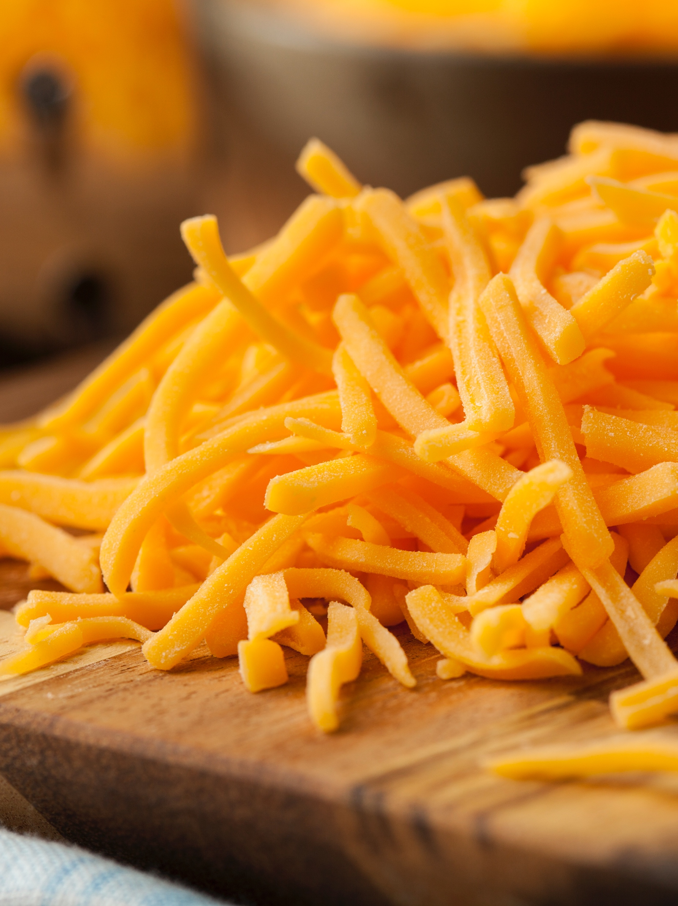
PREPARING SAFE MEALS FOR YOURSELF OR A LOVED ONE
Do not eat anything that contains mold or is expired
Avoid buffets and salad bars
Do not eat any cheeses, milks, or juices that aren’t pasteurized
Avoid pre-cut produce at the grocery store if possible
Notes:
When preparing meals for yourself or a loved one, food safety is always an important consideration. Cancer treatments can sometimes decrease the activity of your immune system increasing your risk for foodborne illness. Germs can get into food during processing, storing, and preparation. You cannot always tell if food is bad by the way it looks, tastes, or smells. To prevent becoming sick from the food you eat, appropriate food safety is necessary. According to the United States Department of Agriculture, there are four basic steps to good food safety: cleaning, separating, cooking, and chilling foods appropriately. Use the following tips:
Do not eat anything that contains mold or that is expired. Buffets and salad bars should be avoided as many people are touching the food, the temperatures aren’t always accurately controlled, and the food is often left out too long. Do not eat any cheeses, milk, or juices that aren’t pasteurized. And avoid pre-cut produce at the grocery store if possible, because they are commonly associated with recalls.
Feel free to share more about food safety

Slide 12
QUESTIONS TO ASK YOUR REGISTERED DIETITIAN OR
HEALTH-CARE PROVIDER
Could you refer me or help me set up an appointment with a Registered Dietitian?
Should I be taking supplements?
I have been losing weight without trying. How can you help me with this?
I have a general disinterest in food, and nothing tastes the same anymore. Will this be my new normal?
Notes:
Being able to talk with the cancer care team about concerns may help you feel more comfortable. They may be able to refer you to a Registered Dietitian. Here are some good questions to ask:

Slide 13
REFERENCES
American Cancer Society. (2014). Physical Activity and the Cancer Patient. Retrieved 11 July 2019, from https://www.cancer.org/treatment/survivorship-during-and-after-treatment/staying-active/physical-activity-and-the-cancer-patient.html
American Cancer Society. (2019). Soy and Cancer Risk: Our Expert’s Advice. Retrieved 11 July 2019, from https://www.cancer.org/latest-news/soy-and-cancer-risk-our-experts-advice.html
American Institute for Cancer Research. Foods to Try During Treatment. Retrieved 12 July 2019, from https://www.aicr.org/patients-survivors/during-treatment/foods-to-try.html
Mayo Clinic. (2018). Cancer Causes: Popular Myths about the Causes of Cancer. Retrieved 11 July 2019, from https://www.mayoclinic.org/diseases-conditions/cancer/in-depth/cancer-causes/art-20044714
University of Texas MD Anderson Cancer Center. (2017). Can a vegetarian diet lower cancer risk? Retrieved 12 July 2019, from https://www.mdanderson.org/publications/focused-on-health/vegetarian-diet-and-cancer-risk.h31Z1591413.html

