Slide 1
Understanding the Basics of Cancer
AGENT NAME
DATE

Slide 2

OVERVIEW
What is Cancer?
Cancer in Kentucky
Types of Cancer
What Causes Cancer
Lifestyle Choices to Prevent Cancer
Common Cancer Terms
Talking to a Health-care Provider

Slide 3
WHAT IS CANCER?
Cancer (CAN-sur): a word used to describe more than 100 diseases in which cells grow out of control; or a tumor with cancer in it
Cancer cells can then spread to other parts of the body.
These cells are unhealthy, and they take over normal cells, making it hard for the body to function normally.
You cannot catch cancer – it is not contagious.
Notes:
Cancer occurs when damaged cells grow and divide uncontrollably in the body. These cancer cells can then spread to other parts of the body. These cells are unhealthy, and they take over normal cells, making it hard for the body to function normally.
It is important to remember that cancer cannot be spread like the flu or a cold; this is called a communicable disease. You cannot “catch” cancer from someone who has it because it is not contagious.

Slide 4

CANCER IN KENTUCKY
Kentucky has the unfortunate distinction of being No. 1 in occurrence and death rates of cancer in the United States.
Eastern Kentucky faces a significantly higher rate
of death and disease than the rest of the state and
country because of heart and lung diseases,
diabetes, and cancer.
Notes:
In the United States, cancer is the second leading cause of death each year. Kentucky faces the highest cancer occurrence and death rates in the United States. Fortunately, through prevention and treatments, those numbers can be reduced. According to the American Cancer Society, Kentucky will have had an estimated 26,400 new cancer cases in 2019, leading to an estimated 10,580 deaths from cancer in Kentucky during the year of 2019.

Slide 5

How many types of cancer are there?
Notes:
Ask class to shout out different types of cancer.

Slide 6

There are more than 200 types of cancer.

Slide 7
Why are there so many types of cancer?
Notes:
Cancer is a disease of cells. Each different type of cell (skin, lung, etc.) gives rise to a different type of cancer.
Different types of cancer can have different causes and are treated in different ways. We are still better at treating some types of cancer than others, but we are making progress. Early detection increases the chances of survival.

Slide 8
COMMON CANCERS
In the United States:
Top cancers in Kentucky 2011-2015:
Colon cancer
Lung cancer
Breast cancer
Cervical cancer
Prostate cancer
Skin cancer
Breast cancer (female)
Prostate cancer
Lung and bronchial cancer
Colorectal cancer
Uterine corpus cancer
Melanoma of the skin
Notes:
Cancer is a word used to refer to several different, but related diseases. Usually cancer is named by what organ it affects first. For example, if cancer is found first in the lungs, it is called lung cancer.
These are the most common cancers. These cancers’ incidence and mortality rates can be reduced through behavior change and early detection screening.
Based on the North American Association of Central Cancer Registries (NAACCR), the top cancers in Kentucky during 2011-2015 were:
Breast (female)
Prostate
Lung and bronchus
Colorectum
Uterine corpus
Melanoma of the skin

Slide 9
SIGNIFICANT CANCER IN KENTUCKY
1st in the nation in overall cancer mortality rate
1st in the nation in incidence rate for all cancer sites
  Lung and bronchus (1st); colon and rectum (1st); larynx (1st);
  oral cavity and pharynx (1st)
Cancer incidence and mortality are highest in Appalachia
Age-adjusted cancer mortality rates, 2010-2014
 | All Cancers | Lung | Colorectal | Cervical
U.S. | 165.6 | 44.4 | 14.7 | 2.3
Kentucky† | 201.5 | 69.6 | 17.2 | 2.8
Appalachian Kentucky | * 226.1 | * 82.4 | * 20.2 | * 3.3
Source: National Center for Health Statistics (NCHS) and KCR. * = p<.05 vs Kentucky as a whole and the U.S.

Slide 10
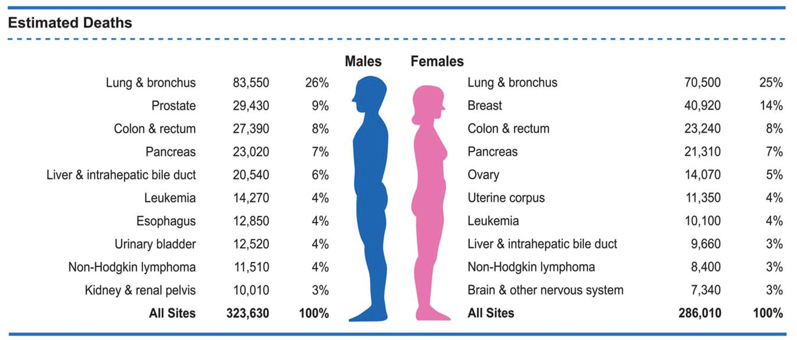
CANCER INCIDENCE AND MORTALITY
Cancer is the second leading cause of death in the U.S.
More than 1.7 million new cases of cancer are diagnosed each year.
  The number of new cases is expected to rise by about 70% over the next two decades
One in three women and one in two men will develop cancer during their lifetimes.
CA: A Cancer Journal for Clinicians. Volume 68, Issue 1, 2018.

Slide 11

WHAT CAUSES CANCER?
Notes:
Why do you think Appalachian Kentucky has higher rates of cancer?

Slide 12
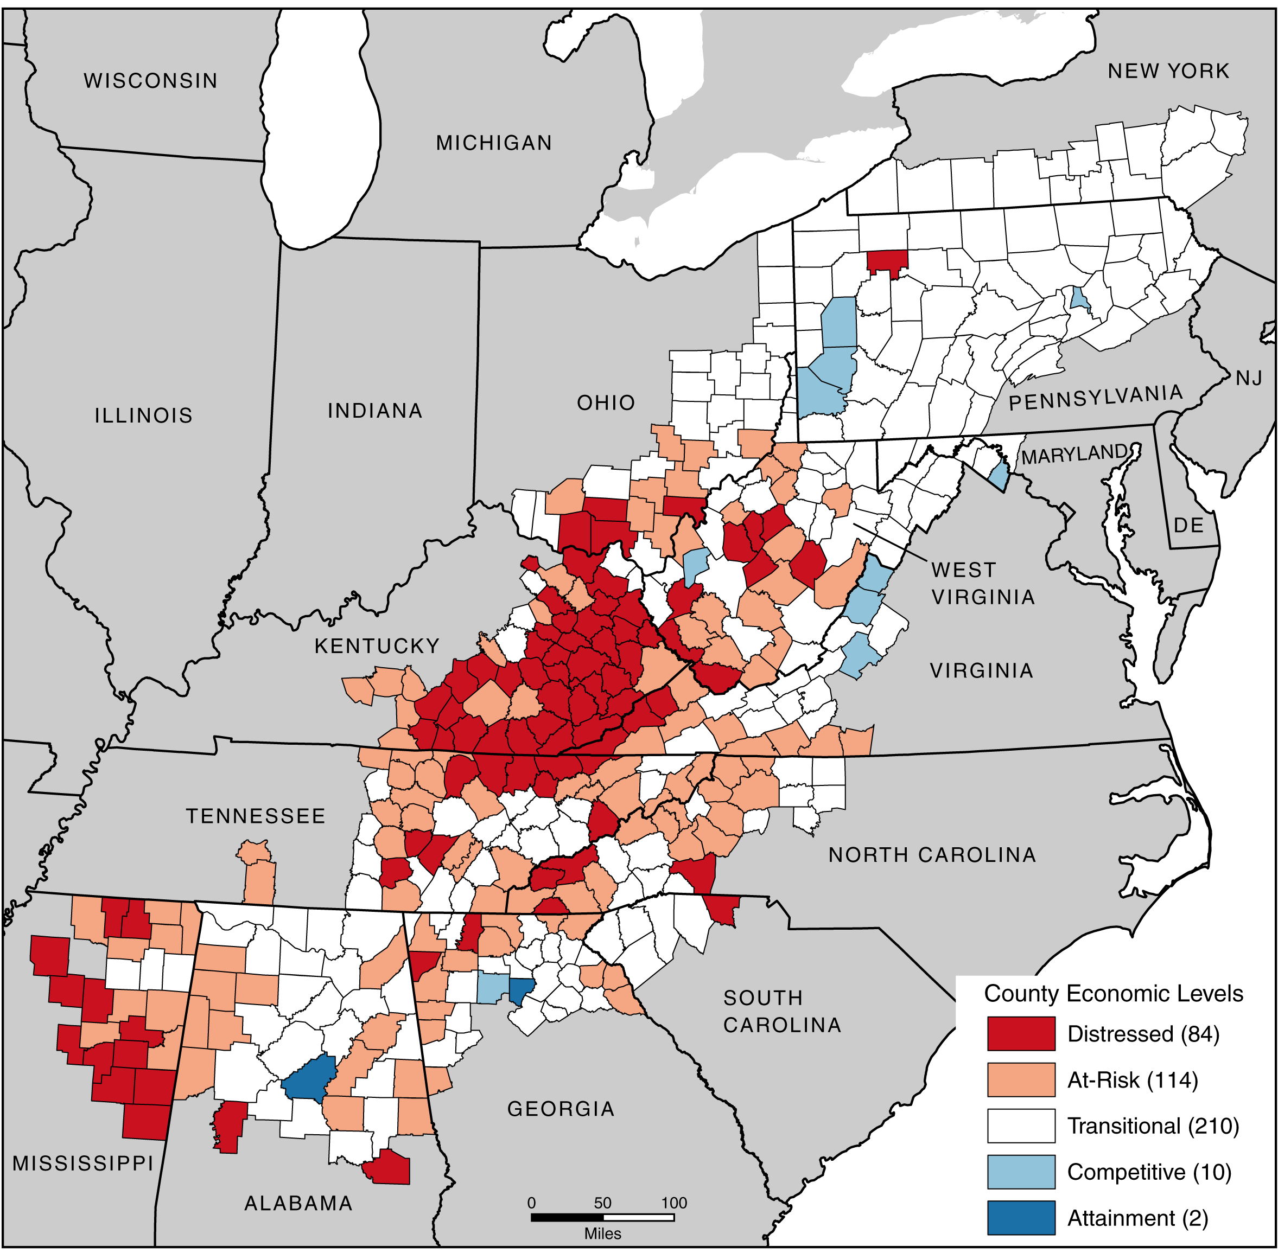
APPALACHIAN KENTUCKY
Cancer
Smoking
Obesity
Chronic
Infection
(HPV & Hepatitis C)
Poverty
Appalachian county economic status (2016-17)

Slide 13
WHAT CAUSES CANCER?
Genetics, but only 5% to 10% of cases are hereditary
Environmental factors like smoke, radon, heavy metals, asbestos, pollutants, etc.
UV light overexposure (sunburns), ionizing radiation (including radon)
Obesity and poor diet
Viruses like hepatitis B and C (HBV and HCV, liver) and human papilloma virus (HPV; cervical, head and neck)
Notes:
Although there are several types of cancer, the underlying cause of all cancers is a change to our DNA – the instructions found in every cell that tells our body how it functions and what it will look like. Specifically, the DNA that controls how cells grow and divide is damaged. This results in unregulated cell growth that requires lots of energy and begins to make normal cells unhealthy. We now know that many different factors can damage the DNA in our cells. These include:
Inheriting mutations in our DNA from our parents or grandparents
Mutations that naturally occur over time that we cannot prevent
Exposure to certain environmental contaminants
Poor lifestyle choices, which we can prevent, that can change our DNA
A combination of factors

Slide 14

WHAT
CAN WE DO?
Notes:
Now that we know a little about the causes of cancer, what do you think we can do to lower our chances of getting cancer?
Discussion about healthy living to prevent cancer and other chronic disease.

Slide 15

LIFESTYLE CHOICES
CAN PREVENT CANCER
Get screened
Maintain a healthy weight
Stay physically active
Eat a healthy diet
Avoid tobacco
Limit alcohol
Protect your skin
Notes:
Lifestyle Choices Can Prevent Cancer
Cancer can happen to anyone, but there are things that everyone can do to help reduce their cancer risk or improve their chances of beating the disease if they do get it. This is a quick summary of behaviors that you can influence in preventing cancer and/or detecting it early to improve survival.

Slide 16
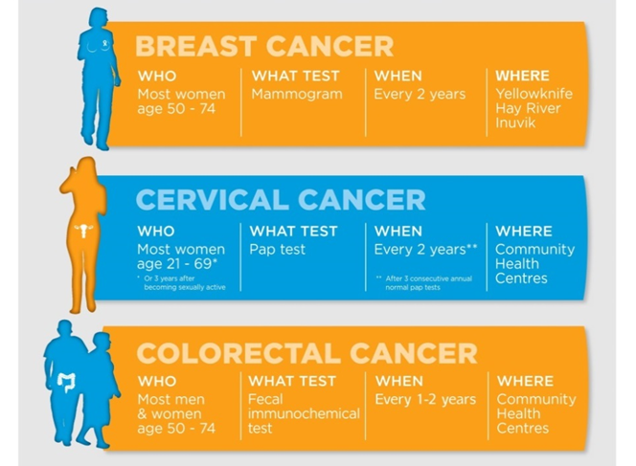
CANCER SCREENING SAVES LIVES
Notes:
It is much easier to treat cancer successfully before it has spread to other parts of the body. That is why early diagnosis is so important; it improves the chances of survival.
Early detection can save lives. Tell your parents and grandparents.
A cancer screening is when a doctor checks for a disease before any symptoms occur. It is never too early to learn about the right age for certain cancer screenings, especially if you or your family members have several risk factors. It is important to know that screenings may not be necessary until later in life or needed earlier if other health factors put you at increased risk. Have conversations with your doctor or health-care provider and encourage your family members to do the same. Examples of common screenings and ages are listed:
•Cervical cancer – women, ages 21-65
•Breast cancer – women, ages 40-74
•Colorectal cancer – everyone, ages 50-75

Slide 17

MAINTAIN A HEALTHY WEIGHT
Avoid excess weight gain at all ages.
For those who are currently overweight or obese, losing even a small amount of weight has health benefits and is a good place to start.
Engage in regular physical activity, and limit your intake of high-calorie foods and beverages.
Notes:
Reduce your cancer risk by achieving and maintaining a healthy body weight. Eat and drink based on your energy needs. It is important that you and your family know what a healthy weight is for your specific height. Everyone is different, and a healthy weight for one person may be very different from another.

Slide 18

STAY PHYSICALLY ACTIVE
Adults should participate in moderate to vigorous activity for a minimum of 30 to 45 minutes, 5 or more days a week.
Activity is shown to reduce the risk of breast and colon cancers.
Children and adolescents should participate in 60 minutes a day of moderate to vigorous physical activity at least 5 days a week.
Notes:
Physical activity has been shown to lower the risk of several types of cancer, including breast, endometrial, prostate, and colon cancers. It also reduces the risk of other serious diseases such as diabetes and heart disease.
•The CDC recommends adults should get at least 150 minutes of moderate-intensity activity (equal to a brisk walk) or 75 minutes of vigorous activity (makes your heartbeat and breathing faster, and makes you sweat) each week.
•Kids should get at least 1 hour of moderate- or vigorous-intensity activity every day.

Slide 19

EAT A HEALTHY DIET
Eat 5 or more servings of fruits and vegetables a day.
Choose whole-grain foods.
Limit your intake of red meat.
Limit your intake of other refined carbohydrate foods, including pastries, candy, sugar-sweetened breakfast cereals, and other high-sugar foods.
Notes:
Diet is linked to some types of cancer, although the exact reasons are not yet clear. Breast cancer, colon cancer, and prostate cancer have been linked to dietary factors and obesity as well as alcohol consumption.
The American Cancer Society recommends eating a variety of healthful foods with an emphasis on plant sources. This includes eating 5 or more servings of vegetables and fruits every day, choosing whole grains in preference to processed or refined grains and sugars, and limiting the consumption of red meats, especially those that are high in fat and processed.
Studies show that eating a variety of different vegetables and fruits, whole grains, and fish or poultry is linked with a lower risk of developing certain cancers. Make fruit, vegetables, and whole-grain foods the basis of your diet. Cut out unhealthy snacks, fast food, and sugary drinks.

Slide 20
AVOID TOBACCO
Tobacco accounts for about 1/5 of all fatal cancer cases.
More than 60 cancer-causing agents are found in tobacco.
If a person stops smoking before lung cancer develops, the lung tissue slowly returns to normal.
Nicotine replacement therapy (NRT), tobacco cessation telephone counseling, and other counseling services have been shown to be very effective in helping someone quit.
One important thing an employer can do is ban tobacco use in the workplace.
Notes:
Tobacco use in the U.S. is responsible for nearly 1 out of every 5 deaths each year. About 80% of lung cancer deaths and 30% of all cancer deaths are caused by tobacco use. If you do not use tobacco products, do not start. If you do use tobacco, try to quit. If you need help quitting tobacco, ask your doctor about stop-smoking products and other strategies for quitting.

Slide 21
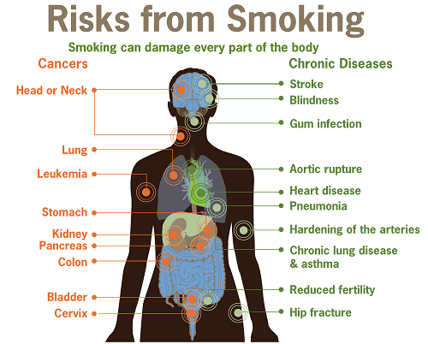

Slide 22
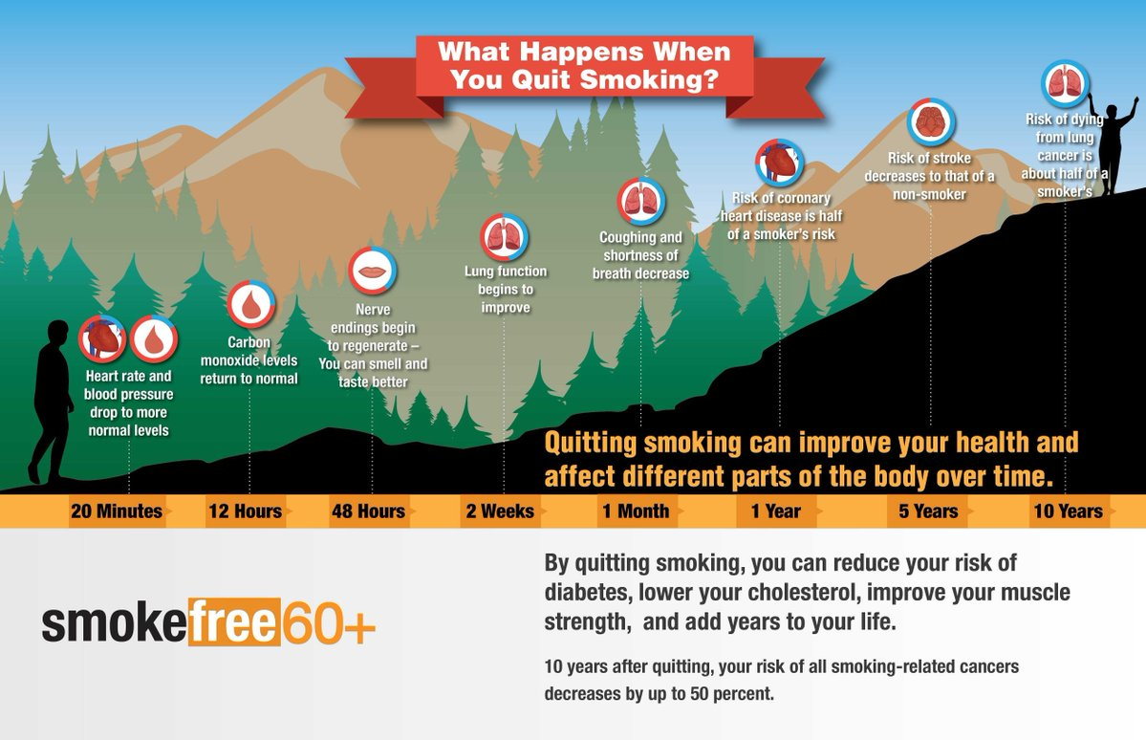
National Cancer Institute

Slide 23
LIMIT ALCOHOL
Avoid excessive alcohol consumption.
If you drink alcoholic beverages, limit consumption.
Drink no more than 1 drink per day for women or 2 per day for men.
With alcohol, it’s very easy to “overpour” or be “overserved” and end up drinking more than you planned.
One drink of alcohol =
12 oz. beer
5 oz. wine
1.5 oz. of 80-proof liquor
Notes:
Research has shown that alcohol can increase your risk for certain kinds of cancer, including breast, mouth, throat, voice box, esophageal, liver, colon, and rectal cancers. The more alcohol you drink, the higher your risk. If you drink, try to stay within the Dietary Guidelines for Americans of up to 1 drink per day for women and up to 2 drinks per day for men. It is important to remember that drinks served at home, restaurants, and bars are usually more than a standard drink. Try replacing alcohol with water on occasion, and picking up some alcohol-free days each week. Cutting down on alcohol will reduce your cancer risk.

Slide 24
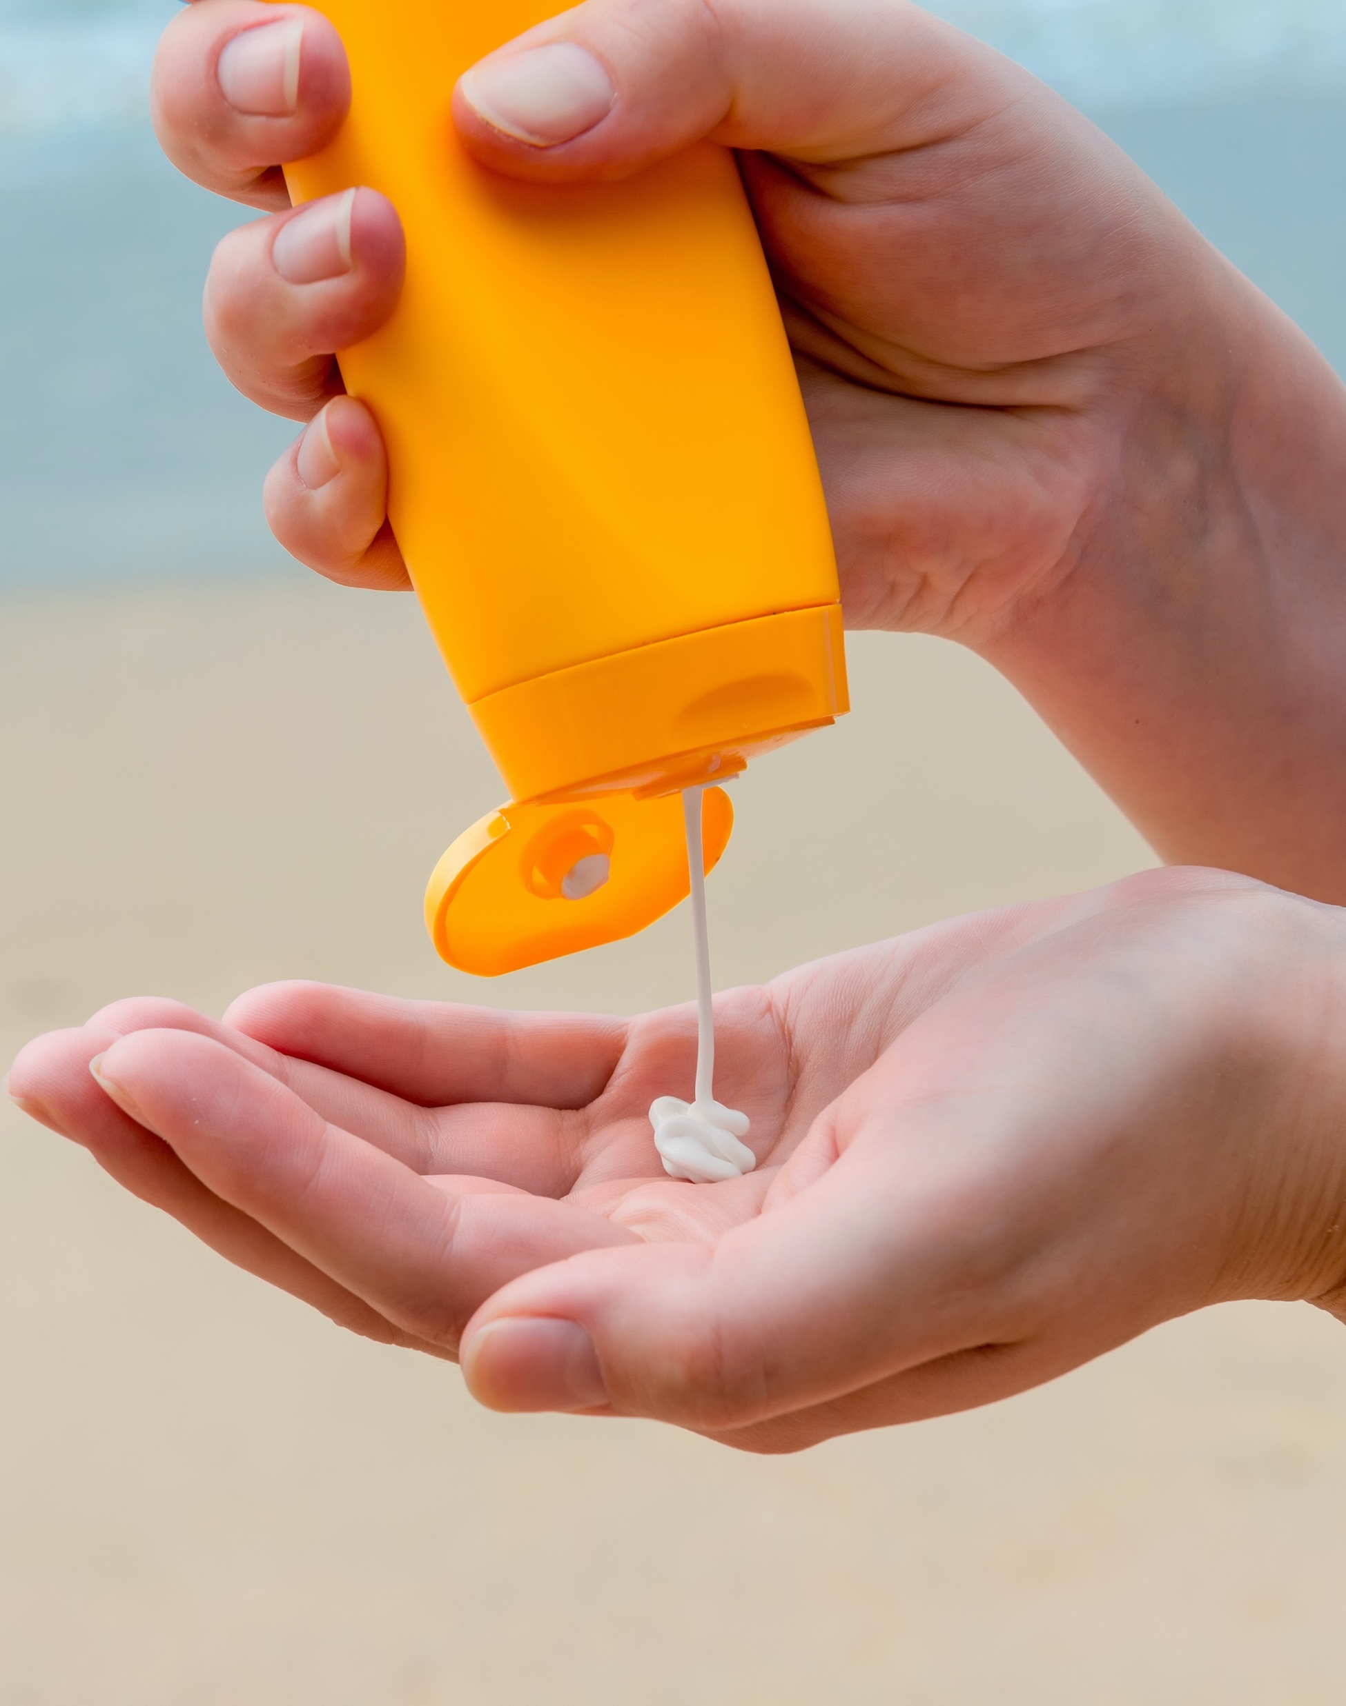
PROTECT YOUR SKIN
Slip on a shirt
Slap on a hat
Slop on sunscreen
Look for shade in the middle of the day
Wear sunglasses
Stay away from tanning beds
Notes:
Skin cancer is one of the most common types of cancer. Some of the best ways to prevent skin cancer is to use sunscreen, limit time in the sun, and stay away from tanning beds.
The good news about skin cancer is that there is a lot you can do to protect yourself from skin cancer or to catch it early enough so that it can be treated effectively. We already talked about what you can do to catch it early. Here we’re going to talk about preventing it.
Most skin cancers are caused by too much exposure to ultraviolet radiation (UV) rays.
The best prevention is to cover up, wear a hat, use sunscreen, and wear sunglasses, or remember the slip, slop, slap method - Slip on a shirt, Slop on sunscreen (SPF of 15 or higher), and Slap on a hat.
Experts recommend products with an SPF of at least 15. The SPF number represents the level of protection against the harmful rays. A higher number means more protection. Using an SPF of 15 means you get the equivalent of 1 minute of UV rays for each 15 minutes you spend in the sun.

Slide 25
Seven Steps to Reduce
Your Cancer Risks
Don’t use tobacco.
Protect your skin from the sun.
Eat a healthy diet.
Maintain a healthy weight, and be physically active.
Avoid risky behaviors.
Get immunized (HPV and hepatitis vaccines).
Seek regular medical care (also know your family medical history, and get regular cancer screenings).

Slide 26
COMMON CANCER TERMS

Slide 27
COMMON CANCER TERMS
Benign (be-NINE): a tumor that is not cancer
Biopsy (BY-op-see): taking out a piece of tissue to see if cancer cells are in it
Cancer (CAN-sur): a word used to describe more than 100 diseases in which cells grow out of control; or a tumor with cancer in it
Chemotherapy (key-mo-THER-uh-pee): the use of drugs to treat disease. The word most often refers to drugs used to treat cancer. Sometimes it’s just called “chemo.”
Malignant (muh-LIG-nunt): having cancer in it
Notes:
During treatment, you may hear your cancer treatment team use these words.

Slide 28
COMMON CANCER
TERMS CONTINUED
Metastasis/Metastasized (meh-TAS-tuh-sis/meh-TAS-tuh-sized): the spread of cancer cells to distant parts of the body through the lymph system or bloodstream
Oncologist (on-KAHL-uh-jist): a doctor who treats people who have cancer
Radiation therapy (ray-dee-A-shun THER-uh-pee): the use of high-energy rays, like x-rays, to treat cancer
Remission (re-MISH-un): when signs or symptoms of cancer are all or partly gone
Stage: a word that tells whether a cancer has spread, and if so, how far

Slide 29
TALKING TO YOUR HEALTH-CARE PROVIDER

Slide 30

TALKING TO YOUR
HEALTH-CARE PROVIDER
Be sure to write down your questions before you meet with a health-care provider.
Take notes on what your doctor says.
Ask if you can record your visits.
Take a family member or friend with you. They can help remind you of questions to ask and take notes for you.
Notes:
There is a lot to learn about cancer and treatment but being able to talk with health-care providers about concerns, may help you feel more comfortable. Here are some ways to help you remember everything your doctor tells you.

Slide 31
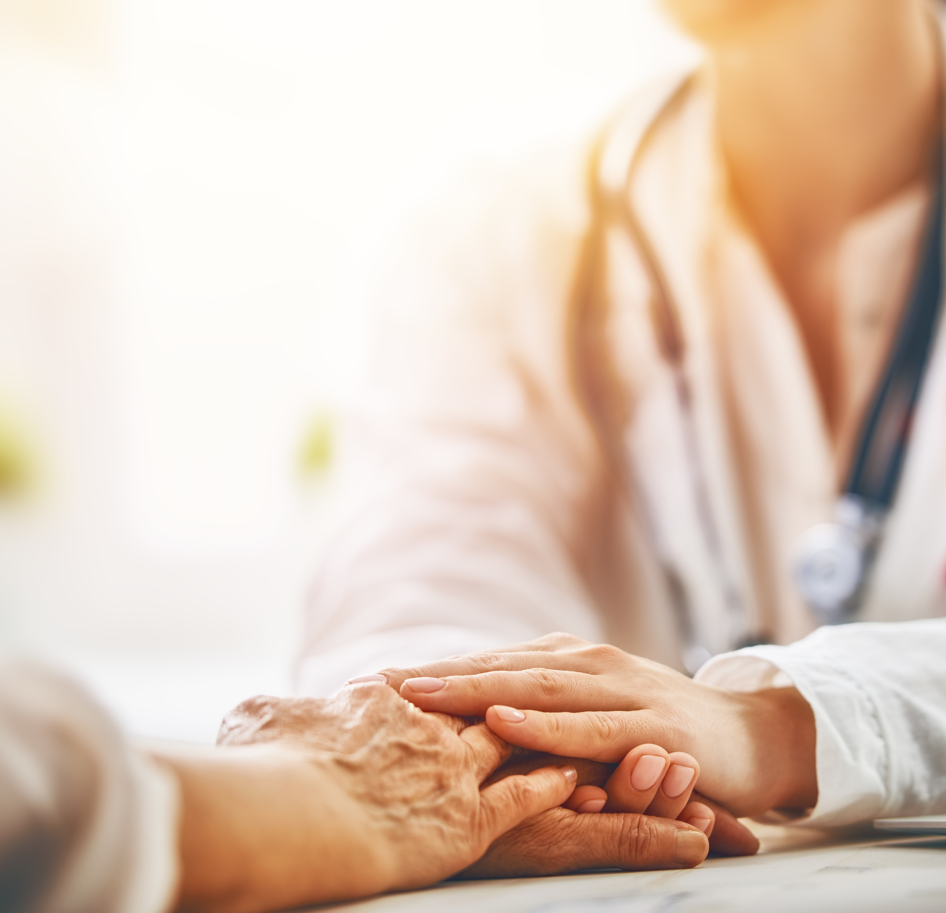
WHAT TO ASK WHEN YOU’RE TOLD YOU HAVE CANCER:
What kind of cancer is it?
Is there a genetic link that I should be aware to inform my children/family members?
Where is the cancer located? Has it spread beyond where it started?
What is the cancer’s stage? What does that mean?
How does this affect my treatment options and long-term outcome (prognosis)?
What are my treatment choices?
Notes:
Do not be embarrassed or afraid about asking questions. Good communication is the key in cancer treatment. All of these questions may not apply to you, but asking the ones that do may be helpful.
Here are some good questions to ask when told you have cancer:

Slide 32
WHAT TO ASK WHEN DECIDING ON A TREATMENT:
How much will I have to pay for treatment? Will my insurance cover any of it?
How long will treatment last? What will it involve? Where will it be done?
What risks and side effects should I expect? What can I do to reduce the side effects of the treatment?
What are the chances the cancer will come back after this treatment?
How will treatment affect my daily activities?
What should I do to get ready for treatment?

Slide 33
WHAT TO ASK DURING TREATMENT:
How will we know if the treatment is working?
What symptoms or side effects should I tell you about right away?
Can you suggest a mental-health professional I can see if I start to feel overwhelmed, depressed, or distressed?
Are there any limits on what I can eat during treatment? What kind of exercise should I do, and how often?
Will I need special tests, such as imaging scans or blood tests, and how often?

Slide 34
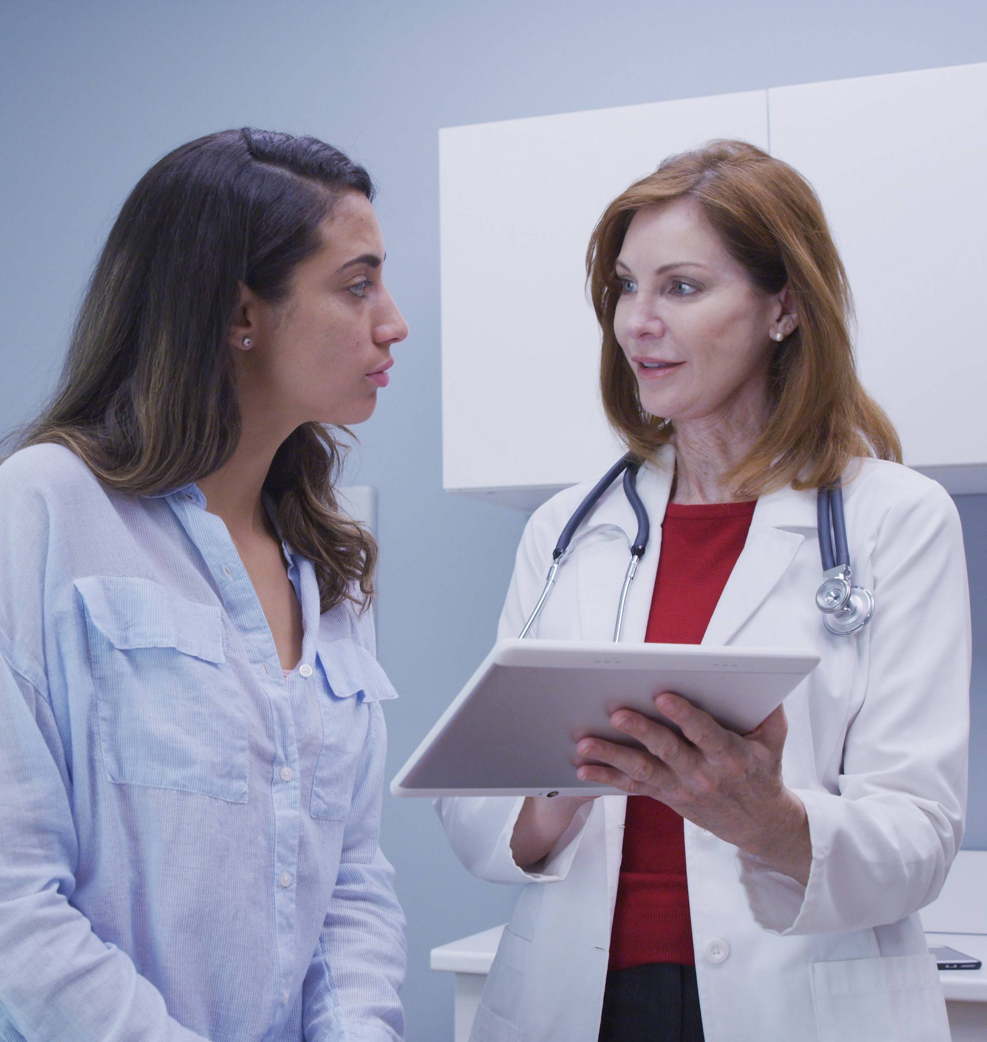
WHAT TO ASK AFTER TREATMENT:
What type of follow-up will I need after treatment?
How will I know if the cancer has come back? What should I watch for?
What are my options if the cancer comes back?
Are there any limits on what I can eat after treatment? What kind of exercise should I do, and how often?

Slide 35
QUICK OVERVIEW AND QUESTIONS

Slide 36
STEPS TO REDUCE
YOUR CANCER RISKS
Don’t use tobacco.
Protect your skin from the sun.
Eat a healthy diet.
Maintain a healthy weight, and be physically active.
Avoid risky behaviors.
Get immunized (HPV and hepatitis vaccines).
Seek regular medical care (also know your family medical history, and get regular cancer screenings).
Be a part of your treatment team (ask questions, and stay informed).

Slide 37
REFERENCES
http://www2.ca.uky.edu/agcomm/pubs/FCS3/FCS3616/FCS3616.pdf
https://www.cancer.org/cancer/cancer-basics/what-is-cancer.html
https://cancerstatisticscenter.cancer.org/?_ga=2.250724100.341714021.1567711741-2081424837.1566955791#!/state/Kentucky
https://www.cancer.gov/about-cancer/understanding/what-is-cancer
Anand, Preetha et al. “Cancer is a preventable disease that requires major lifestyle changes.” Pharmaceutical research vol. 25,9 (2008): 2097-116. doi:10.1007/s11095-008-9661-9
Khan, Naghma et al. “Lifestyle as risk factor for cancer: Evidence from human studies.” Cancer letters vol. 293,2 (2010): 133-43. doi:10.1016/j.canlet.2009.12.013
https://www.cancer.gov/about-cancer/causes-prevention/risk
https://www.cancer.org/latest-news/6-steps-to-help-lower-your-cancer-risk.html
https://www.cancer.gov/about-cancer/coping/adjusting-to-cancer/talk-with-doctors
https://www.canceradvocacy.org/resources/communicating-with-your-doctor/asking-questions-who-when-how/
https://www.cancer.org/treatment/finding-and-paying-for-treatment/choosing-your-treatment-team/the-doctor-patient-relationship.html
https://www.cancer.org/treatment/finding-and-paying-for-treatment/choosing-your-treatment-team/questions-to-ask-your-doctor.html
https://www.cancer.org/content/dam/cancer-org/cancer-control/en/worksheets/questions-to-ask-about-my-cancer.pdf
North American Association of Central Cancer Registries (NAACCR), 2018
https://ukhealthcare.uky.edu/sites/default/files/markey-cancer-center-annual-report-2018.pdf

