Slide 1

Navigating Trauma
After a Natural Disaster
Kentucky Extension Homemakers Association (KEHA) Leader Lesson
Dr. Paul Norrod and Laura Weddle

Slide 2
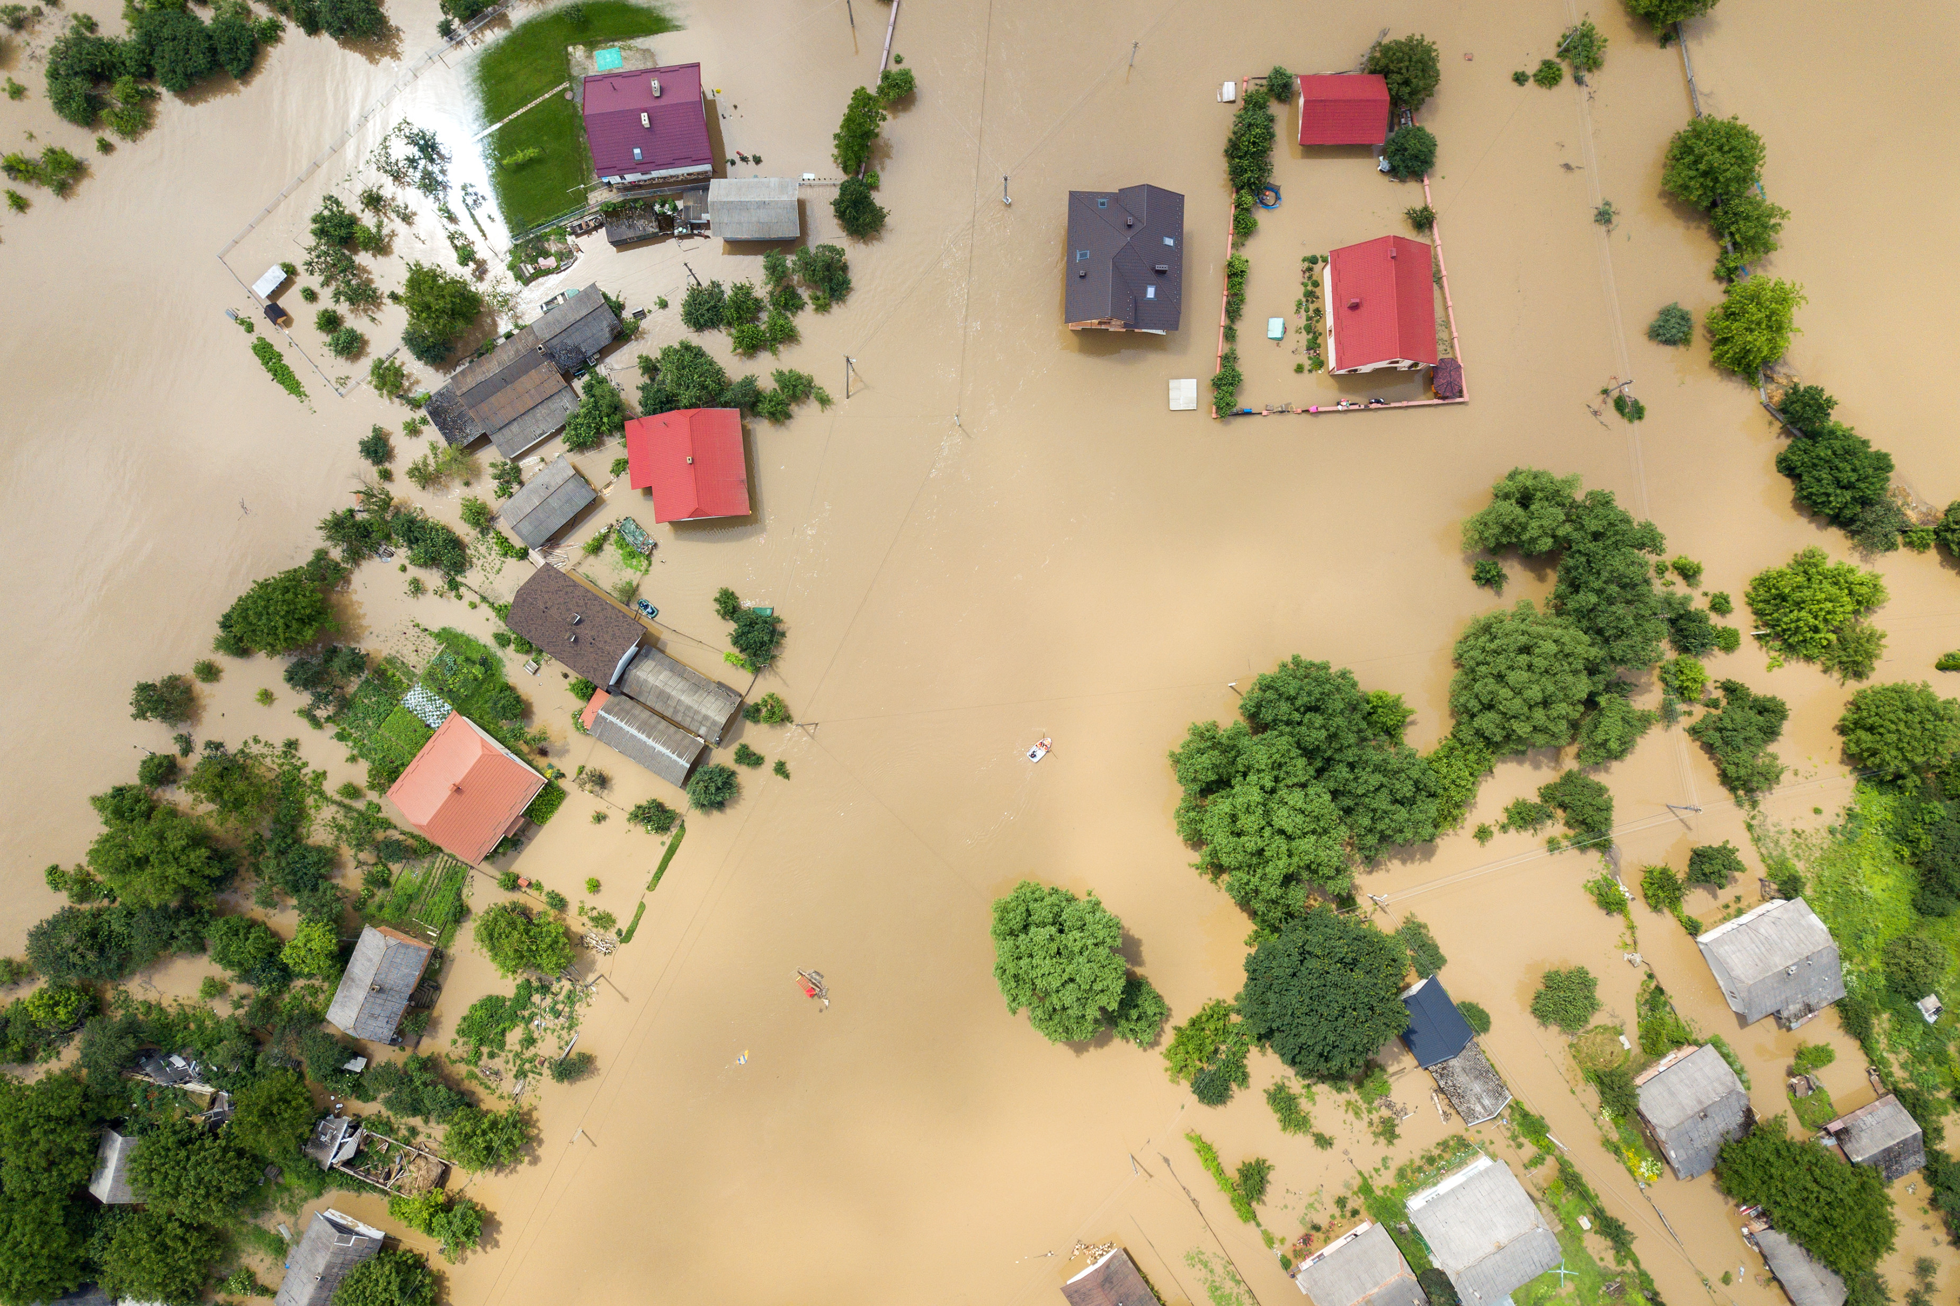
Lesson Objectives
Understanding trauma and its effect on the body
Recognizing signs of trauma
Coping with trauma
Helping others cope with trauma

Slide 3

Difficult Content Warning
Painful memories are possible.
You might experience emotional discomfort.
It’s OK to step away.

Slide 4

Defining Trauma
  Nervous system response to uncontrollable (natural disaster) event
  Event = physically life-threatening or emotionally harming
  Highest amount of stress
  Disrupts our ability to cope
Notes:
Trauma is our response to a physically life-threatening and/or emotionally hurtful event that is usually uncontrollable, such as a natural disaster. We can think of trauma as the highest amount of stress, but the event makes it difficult to cope because of the significant loss of relationships or things necessary to meet our basic needs.
People and communities are different and not everyone who survives a natural disaster experiences trauma. In many cases, the more devastation, and fewer social and physical resources, the more likely a person and community is to experience trauma.

Slide 5
How Does Trauma Affect the Body?
Traumatic event happens
Sympathetic Nervous System
(Survival System) Activated
Brain signals release of stress hormones
Blood flow diverted to heart, lungs, liver, and muscles
Stress hormones impair thinking and ability to cope
Event permanently stored in brain as painful memory or emotion
Memory of event or fear of new event activates survival system
Individual reexperiences the trauma of the prior event
Brain and survival system remain on alert after event
Notes:
When we experience trauma because of an uncontrollable event, it activates our survival system, often called our fight-flight-freeze response. Once the survival system activates, it remains active until we do something to calm it down.
Sympathetic Nervous System (fight-flight-freeze): The sympathetic nervous system involves part of our brain and spinal cord. We can think of it as our survival system. The survival system is responsible for our survival against things considered threatening. When activated, the survival triggers a fight, flight, or freeze response in our body. A way to think about how the survival system function is to consider the last time you were scared by something. During that time, you either jumped, ran, or stood still. That’s the survival system.
Review the effects of trauma on the body from the slide.

Slide 6
Signs of Trauma
Immediate (<3 months after event)
Using items around you to protect your head
Feeling numb or like nothing is real
Problems focusing or feeling confused
Easily startled or scared
Intense anger or sadness
Heart races when thinking about the event
Difficulty sleeping or having nightmares
about the disaster
Long-term (>3 months after event)
Feeling irritable or bitter
Difficulty thinking or making decisions
Socially isolating from family or friends
Avoiding places or things that bring back
painful memories of the event
Easily startled or scared by certain sights or
sounds
Worrying or fearful about future disasters
Notes:
Share the immediate signs of trauma listed on the slides. Point out that the immediate signs usually occur immediately after and within three months of the event.
Share the long-term signs of trauma listed on the slides. Point out that the long-term signs usually occur more than three months after the event and that people may experience these signs years afterward.
Activity #1 (5-7 minutes)
Materials: Crayons, markers, and paper.
Ask participants to consider the differences between immediate and long-term signs of trauma. Instruct participants to use different colored crayons or markers to describe the different feelings associated with immediate versus long-term signs of trauma. After the time allotted, ask one table to report the differences they noted and talk about their colors.

Slide 7
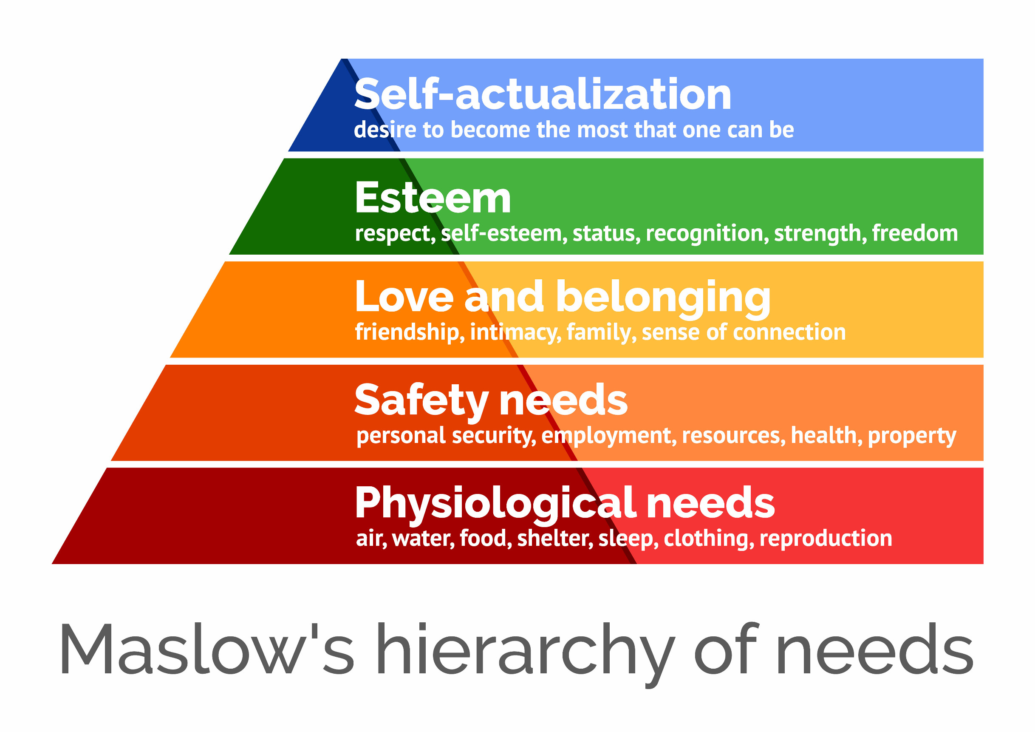
Prioritize Basic Needs
Food (nonperishable)
Water (bottled)
Safety (avoid unsafe
conditions)
Shelter (undamaged
structures)
Clothing (dry socks, pants,
shirt, jacket)
Notes:
Share: Prioritizing basic needs is important to maintaining safety, health, and resilience and restoring a sense of normalcy. Basic needs are just that, the very basic things we need to survive and include food, water, safety, shelter, and clothing.
Basic Needs: Basic needs are the materials and resources needed to survive. Basic needs also include relationships to help us cope with our problems and obtain materials and resources to survive. In the image, you can see how our needs should be prioritized with basic needs serving as the foundation for our life.
Review the basic needs list from the slide.

Slide 8
Caring for Yourself and Others
Use compassion and caring in dealing
with others.
Offer supportive words to yourself
and others.
Spend time or reach out to family
and friends daily.
Avoid the use of alcohol or drugs.
Reduce or avoid consumption of
news.
Delay making major life decisions.
Acknowledge your emotions. One day,
you may feel angry, then feel
overwhelmed or sad.
Give yourself grace. Feeling sad,
worried, and angry is OK.
Try to get “good” sleep.
Remain flexible. Changes will occur.
Seek professional support from a
physician or counselor.
Notes:
Share: Caring is a concept that we may overlook when experiencing trauma that results from a natural disaster. However, caring for yourself and others is imperative to minimizing the effects of trauma and maximizing our ability to recover from the disaster.
Review the tips to care for yourself and others on the slide.

Slide 9

Restoring Routine
Eat at the same time each day.
Drink plenty of water.
Take time for rest to boost your recovery.
If possible, take your medicines.
Take time to grieve.
Talk daily to someone you trust.
Wake up and go to bed at the same time.
Notes:
Share: Last, but certainly not least, is restoring your routine after a natural disaster. It is important to restore a routine because it helps deactivate the survival system and minimize the long-term effects of trauma. You can also restore your routine while meeting your basic needs like eating at the same time each day or with the same person.
Review the restore your routine tips.
Ask participants to share a routine that might help them recover.

Slide 10

Helping Others
Keep interactions compassionate.
Prioritize physical safety and basic needs.
Look for signs of trauma and provide support.
Give information about coping and connecting
with professionals.
DO NOT make promises.
Give information, DO NOT give advice.
Notes:
Share: Helping others models the activities that you would use to cope with trauma with a few additions.
Review the four tips to helping others from the slide.
Share: People experiencing trauma after a natural disaster may have difficulty thinking and making decisions. They may be emotionally overwhelmed. Acting calm, showing compassion, and prioritizing basic needs are important to help minimize the effects of trauma and shut down the survival system. During the short-term and long-term periods after the disaster, we should look for signs of trauma in others while providing emotional and physical support.
It is also important to give information and not advice. Advice does not give the survivor any advantage but only minimizes their ability to recover. Think of it this way, advice is not clean, dry clothes, fresh water, or comforting. Advice will not restore the things or people that were lost. Instead, give information.
Information should be simple and tangible and provide for emotional and physical needs. Examples of simple information can be a phone number to call for support, the location of a shelter, or where to obtain food and water.
Lastly, DO NOT make promises such as, “We’ll find everyone,” “We will rebuild your house,” or “You will get all the help you need.”
Activity #2 (7-10 minutes) Survival Story
Materials: Crayons, markers, and paper.
Share: The story is designed to get us thinking about how we can apply the knowledge and skills discussed in today’s lesson. Please take a few minutes to read the story and consider the questions at the bottom of it. Then, talk about your answers at the table.
Consider using some different colored markers or crayons to describe the trauma, the feelings, needs, and resource that the survivors may need.

Slide 11

Call or Text 988
Notes:
Share: After a natural disaster, it is important to connect people who experience trauma with a professional. Connecting with professionals can include working with first responders or primary care providers; however, it’s important to connect persons with mental health professionals. In Kentucky, you can call or text 988 to connect with a crisis counselor and mental health professional.

Slide 12
This presentation is part of the Kentucky
Family and Consumer Sciences Extension program,
In the Face of Disaster.
Copyright © 2023 for materials developed by University of Kentucky Cooperative Extension. This publication may be reproduced in portions or its entirety for educational or nonprofit purposes only. Permitted users shall give credit to the author(s) and include this copyright notice.
Educational programs of Kentucky Cooperative Extension serve all people regardless of economic or social status and will not discriminate on the basis of race, color, ethnic origin, national origin, creed, religion, political belief, sex, sexual orientation, gender identity, gender expression, pregnancy, marital status, genetic information, age, veteran status, physical or mental disability or reprisal or retaliation for prior civil rights activity. Reasonable accommodation of disability may be available with prior notice. Program information may be made available in languages other than English. University of Kentucky, Kentucky State University, U.S. Department of Agriculture, and Kentucky Counties, Cooperating.

